Slide 1
Saint Louis University
Laboratory Inspections

Slide 2
Why Are Inspections Important?
Ensure a safe work environment for SLU employees, students, and visitors
Determine compliance with federal, state, and local regulations
  OSHA, NIOSH, EPA, MoDNR, CDC, USDA, NRC and others
Identify hazards and areas of concern before incidents occur
Identify corrective actions
Identify best practices to address concerns
Lab personnel are encouraged to proactively perform self-inspections

Slide 3
Types of Laboratory Inspections
Inspection | Relevant Laboratories | Frequency
Environmental Safety | All laboratories. | Annually
Biological Safety | Labs using biological agents (BSL-2 agents or higher, recombinant or synthetic nucleic acid molecules (rsNA), or toxins). | Annually
Radiation Safety | Laboratories approved for radioactive materials use. | Quarterly

Slide 4
General Safety
All inspections look for common general safety items to ensure safe work practices.
Training
  Lab Safety, Lab-Specific (general and biosafety), Radiation Safety
Personal Protective Equipment
Engineering controls
  Biological safety cabinets, fume hoods, compressed gas restraints
Eyewashes

Slide 5
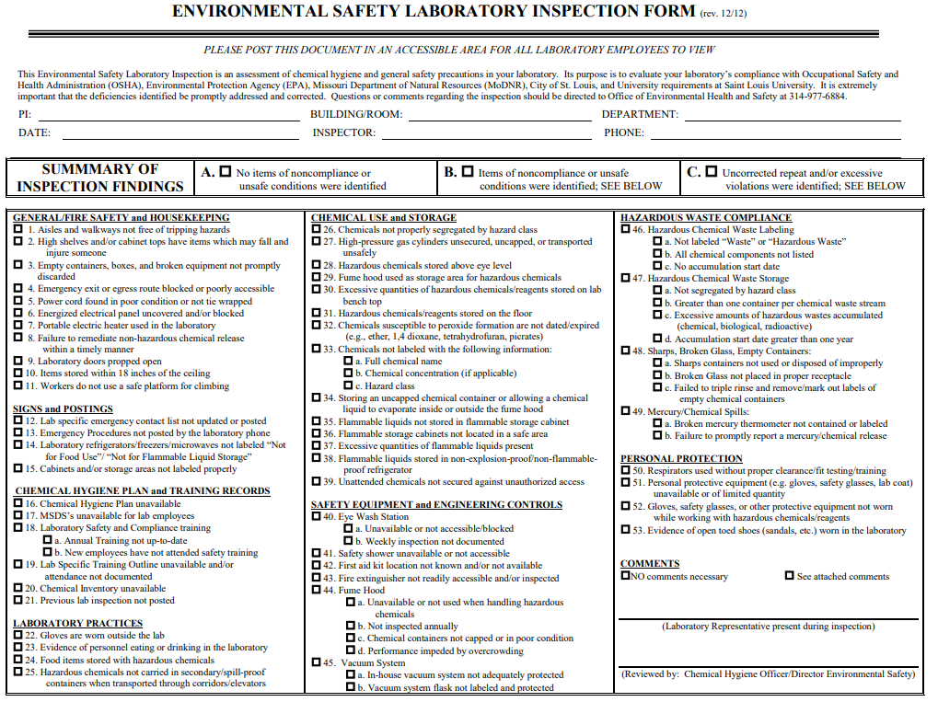
Environmental Safety Laboratory Inspections
Performed annually.
Covers general safety, chemical safety, and hazardous waste.
Laboratories are expected to make corrections to compliance issues noted during the inspection.

Slide 6
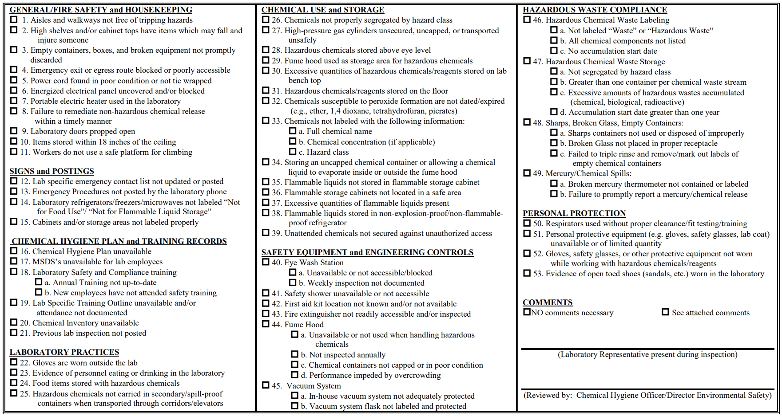
Environmental Safety Laboratory Inspection Form

Slide 7
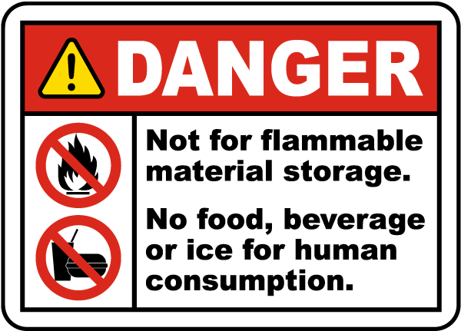
Most Common Areas of Noncompliance
Chemicals not labeled with the full chemical name, concentration and/or hazard class.
Laboratory refrigerators/freezers/microwaves not labeled “Not for Food Use” & “Not for Flammable Liquid Storage”.
Flammable liquids stored in non-explosion-proof/ non-flammable-proof refrigerators.
Chemicals not properly segregated by hazard class.
Vacuum systems not adequately protected with in-line filters.

Slide 8
Environmental Safety Highlights
Broken glass boxes are designed for disposal of clean broken glass, glass bottles that have been tripled rinsed and other sharp glass that is not contaminated. Please triple rinse glassware and mark out or remove labels before disposal in the broken glass box.
All peroxide-forming chemicals (diethyl ether, picric acid, tetrahydrofuran, etc.) must be dated when received and dated when opened. Please do not open if expired or crystals have formed inside the bottle. Request a chemical waste pickup.
Food and drinks are not allowed inside the laboratory. Each lab should have a designated area to ensure food and drink are not used or stored in the lab.
Minors (< 18 yrs old) are not allowed to access or work in the laboratory without official approval. Consult the EHS Minors in Labs Policy.

Slide 9
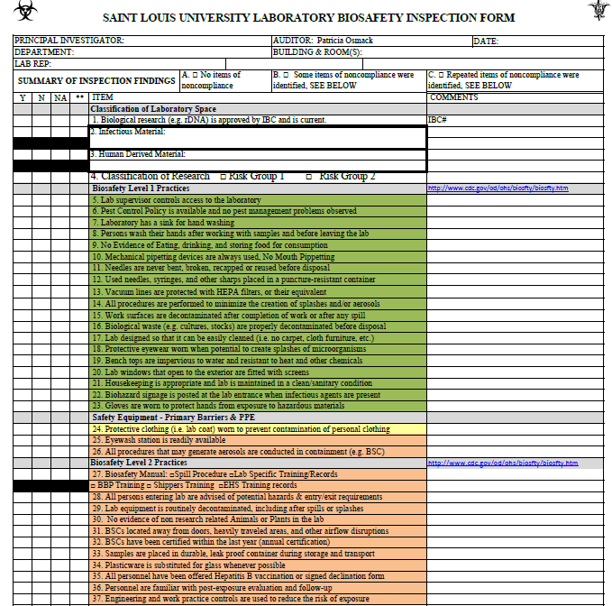
Biosafety Inspections
Performed annually and anytime lab locations or work practices change.
Required for Institutional Biosafety Committee Protocol approval.
Typically not announced but are usually performed the same month every year.

Slide 10
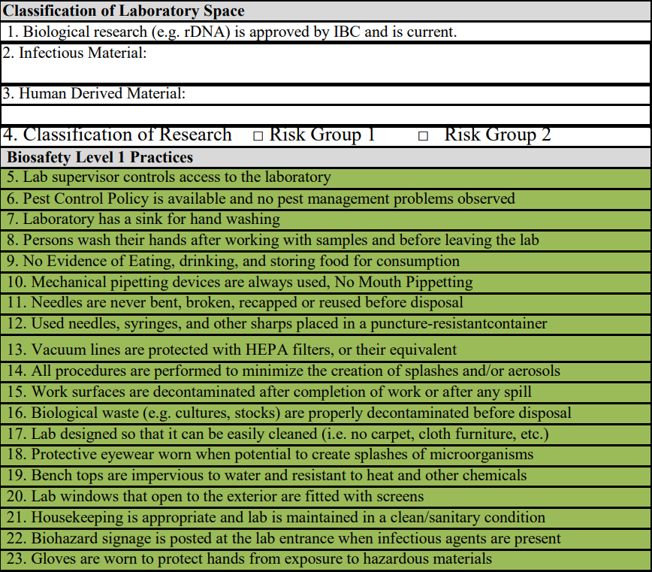
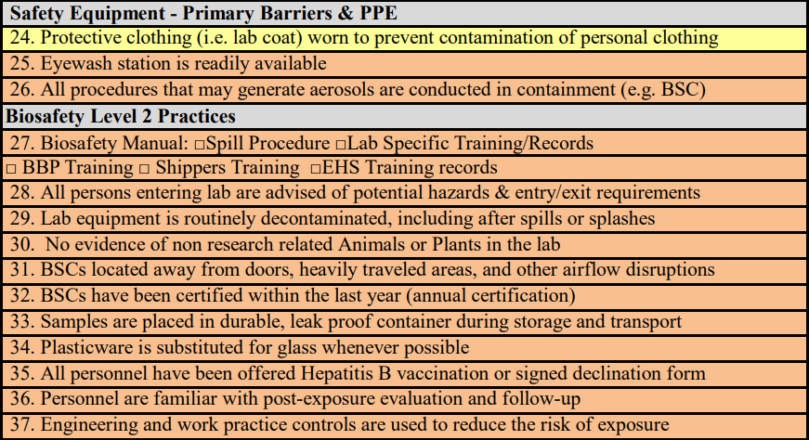
Biosafety Inspection Form

Slide 11
Common Areas of Noncompliance
Biological Safety Cabinet not certified within 12 months.
Eyewash not flushed weekly and recorded.
Vacuum flasks missing HEPA filters between flask and vacuum source.
Not wearing appropriate PPE according to biosafety level and eIBC protocol.
Incorrect disposal of biological waste.
Sharps not handled/stored/disposed of properly.
Plants in labs.

Slide 12
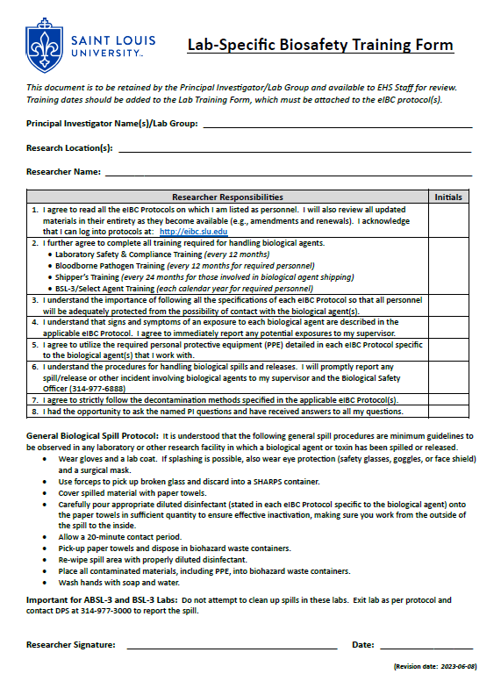
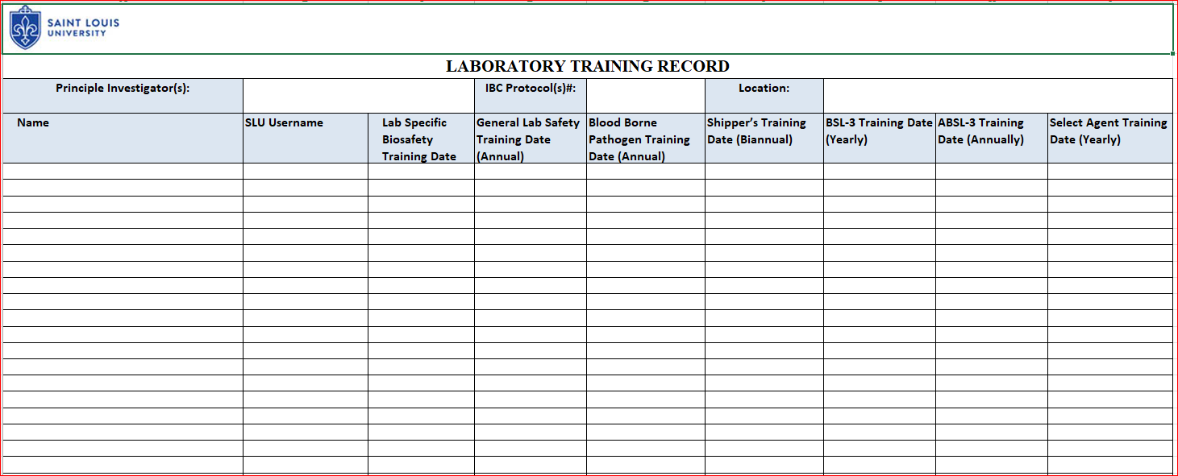
Biosafety Inspection Highlights
Lab-specific biosafety training records for all personnel should be maintained in the research space.
Training records should be documented on the Laboratory Training Record spreadsheet to be attached to the eIBC protocol.

Slide 13
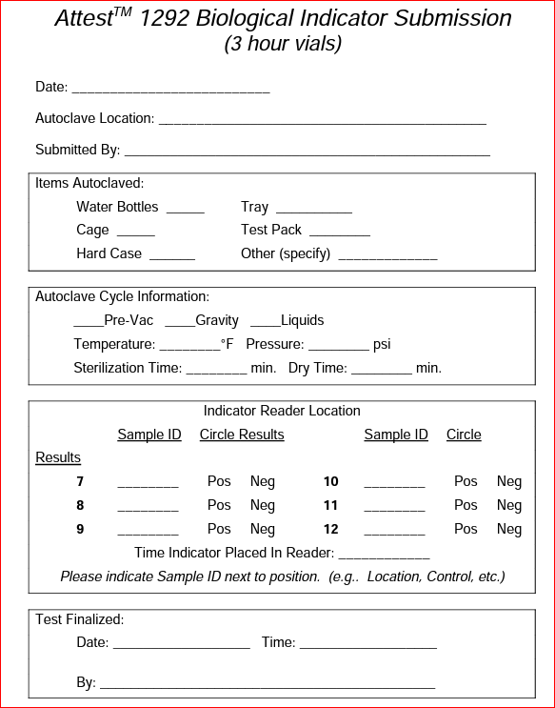
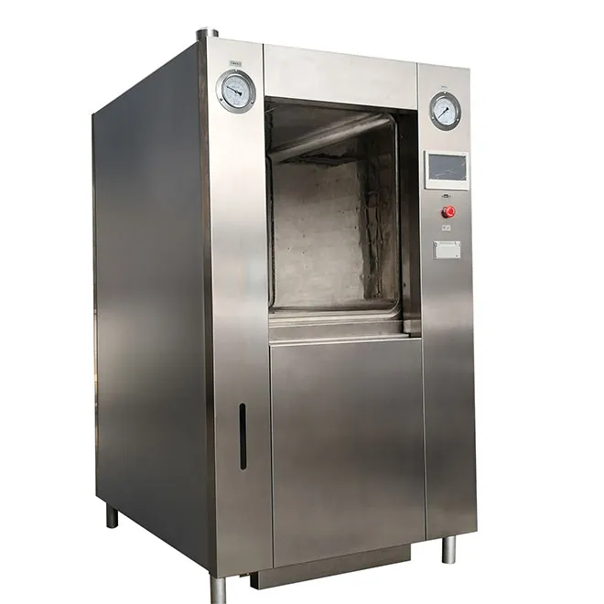
Autoclave Inspections
Autoclave function must be validated weekly (spore tests) when the autoclave is used to decontaminate waste.
Autoclave records are checked annually.

Slide 14
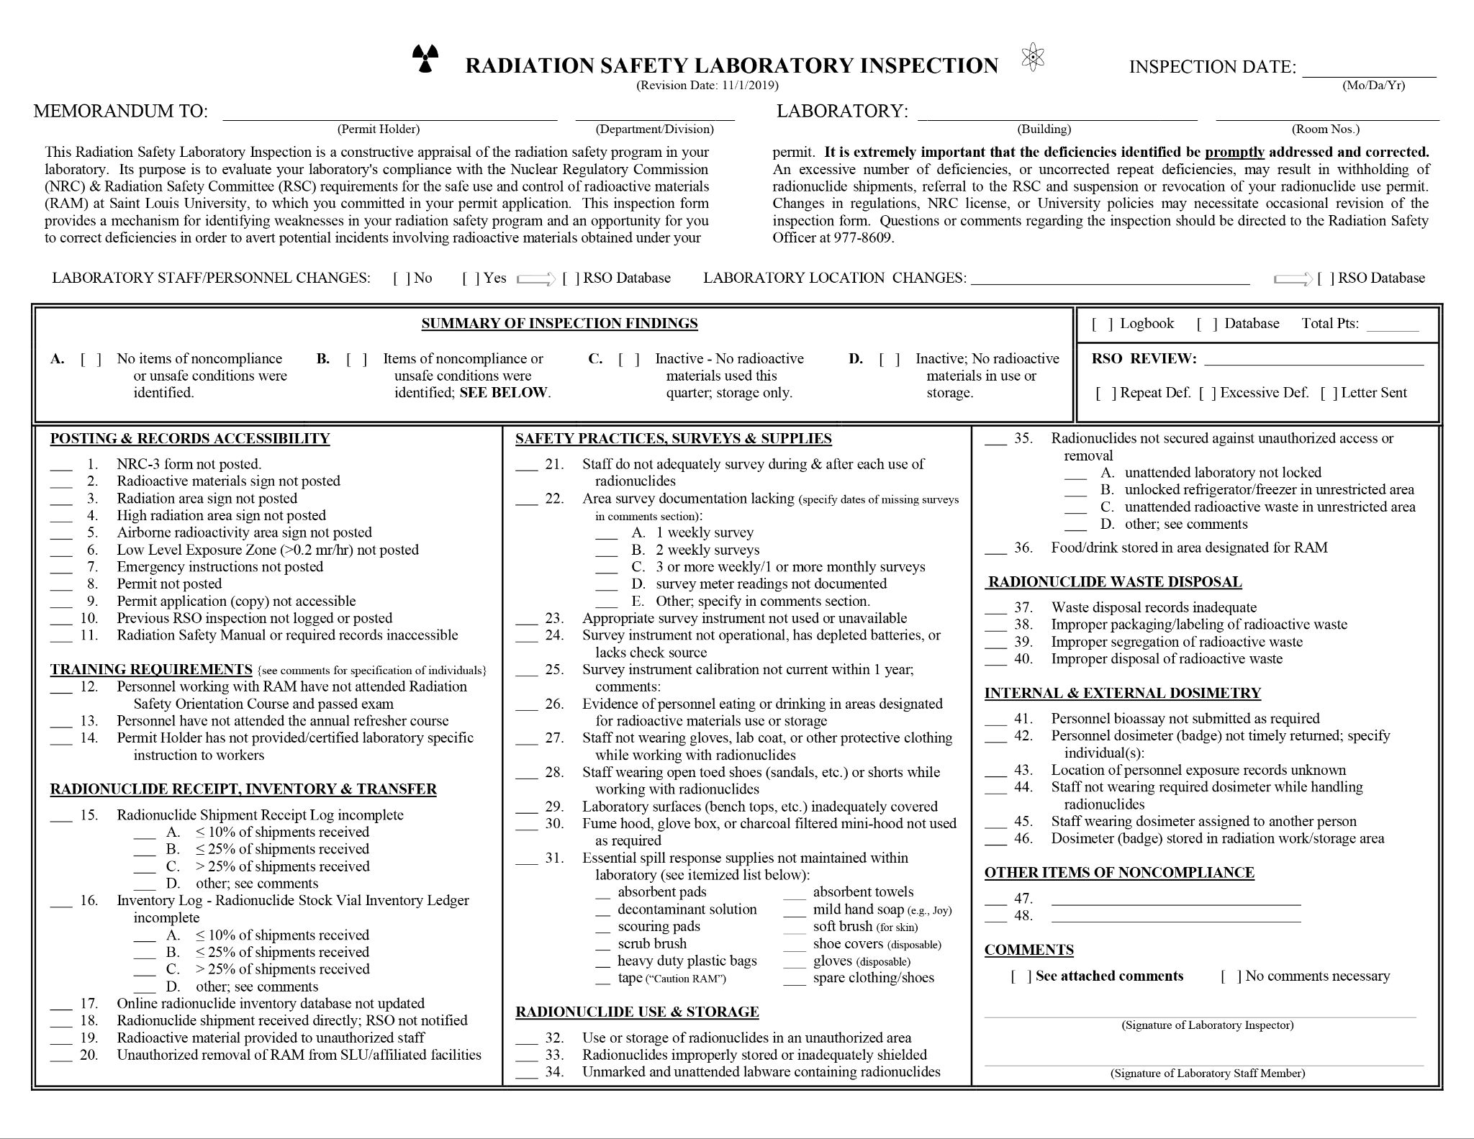
Radiation Safety Inspections
Training: All personnel working with radioactive materials must have completed the Radiation Safety Orientation and passed the associated test
Radionuclide Shipment Log (Green Sheet): must be completed as required including surveys and inventory log
PPE: Appropriate PPE must be worn for the radioactive materials being used. Typically, this includes lab coat, gloves, protective eyewear, and dosimeters if required
Surveys: Survey meter readings (unless H-3 use only, which is not detectable with meter) and wipe tests must be documented weekly. Surveys of personnel and nearby area required following all procedures involving radioactive materials (no documentation required)
Inventory: A quarterly physical inventory of all radionuclides must be completed. This includes all radioactive materials on hand, whether in stock vials, experiments, or waste. The online Radiation Safety database must be updated by the Permit Holder/lab following the inventory
Security: Radionuclides must be secured against unauthorized access or removal at all times
Food and Drink: No food and drink is allowed in any laboratory where radioactive materials are used or stored

Slide 15
Radiation Safety Inspection Form

Slide 16
Summary
Contact ehs@slu.edu for any questions regarding inspections.
Please complete the Safety Awareness Quiz on Laboratory Inspections by September 30th, 2023.

