Slide 1
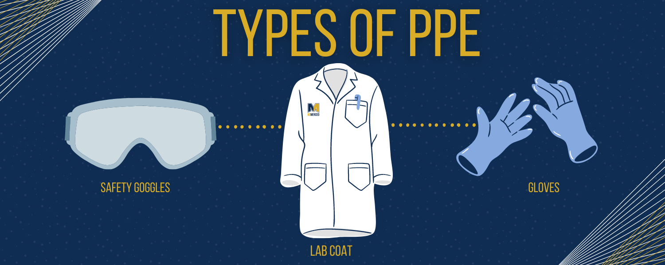
Saint Louis University
Personal Protective Equipment
(PPE)

Slide 2

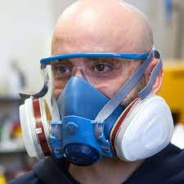
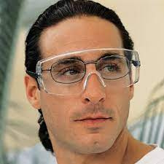

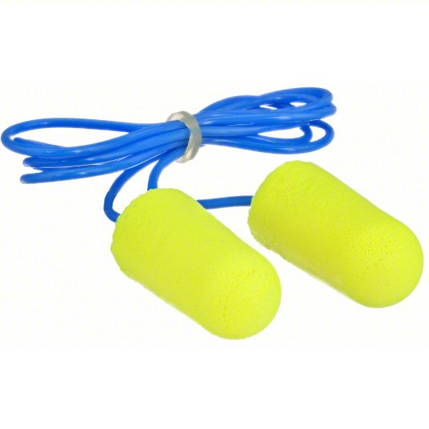
What is PPE?
Clothing or equipment designed to reduce employee exposure to chemical, biological, and physical hazards.
Often the last line of defense for prevention of occupational injuries, illnesses, and fatalities.
Should be combined with other control measures to ensure a safe and healthy environment.
Protects employees when engineering and administrative controls are not feasible or when they fail.

Slide 3
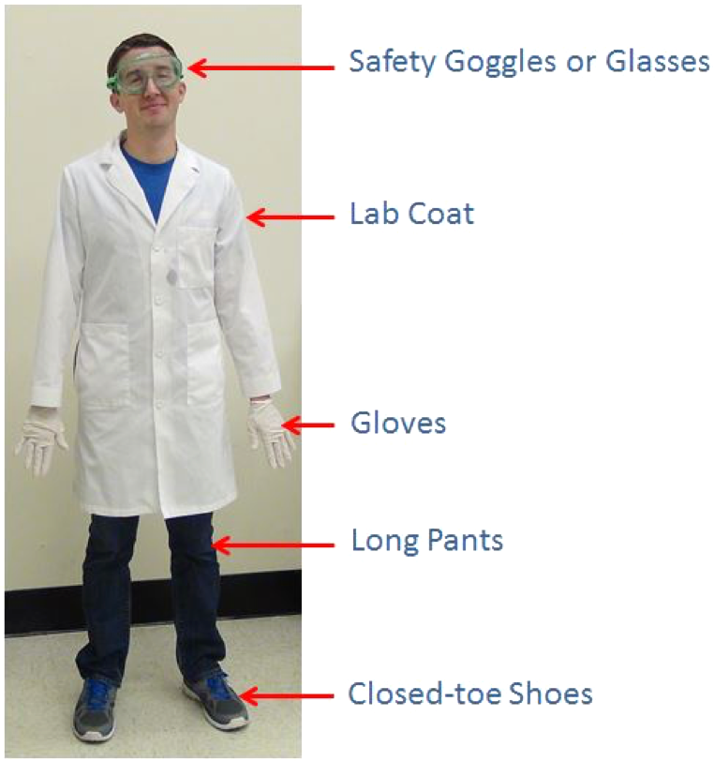
Basic PPE

Slide 4

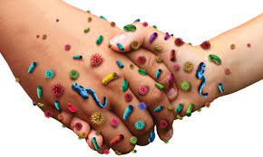
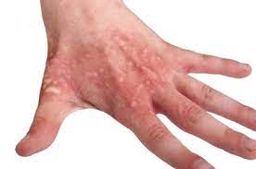
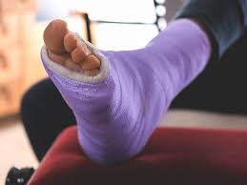
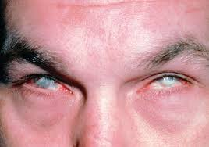
Why is PPE Important?
PPE protects your body from:
  Cuts
  Lab-acquired infections
  Chemical burns
  Damaged vision
  Broken bones
  Sprains
  Lost limbs
These illnesses or injuries could cause acute or chronic symptoms, and could be life threatening.
Dermal Contact
Slips/trips/falls
Chemical Splash

Slide 5
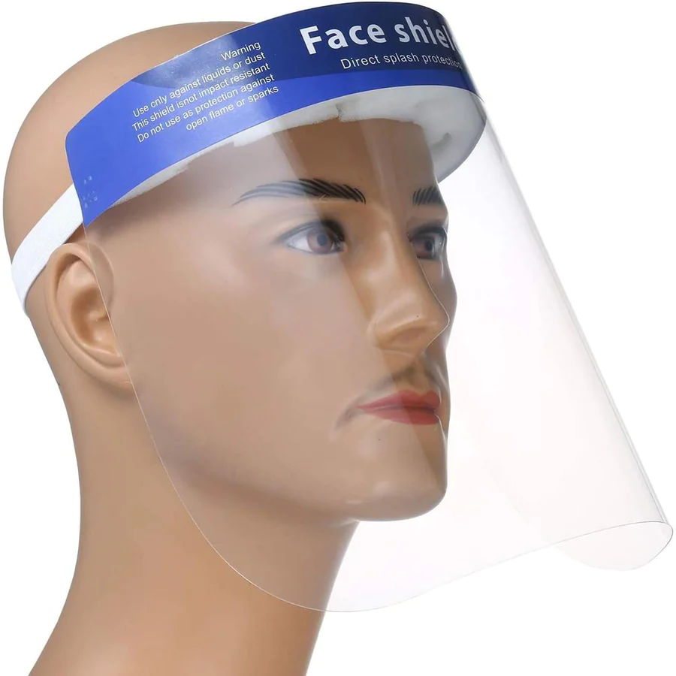
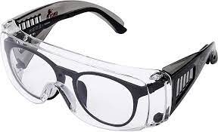
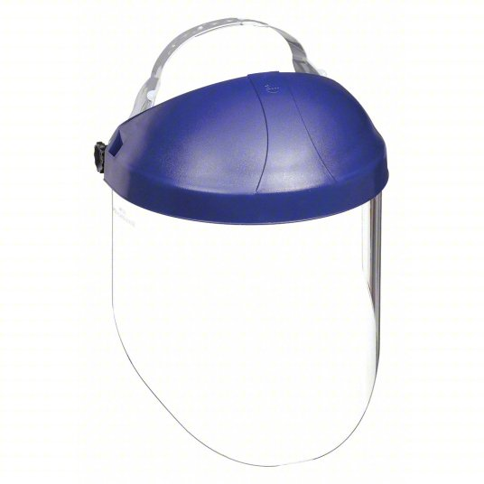
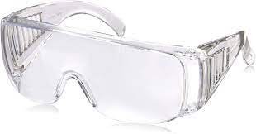
Eye Protection
Eye protection including safety glasses, face shields, and goggles should always be worn when working in the laboratory to protect your eyes from chemical splashes, cuts, and debris.
If you wear prescription glasses, make sure to put safety glasses or goggles over them, or have your prescription glasses customized into safety glasses after approval from your eye doctor.

Slide 6
Lab Coats
Lab coats help protect you and your clothing from spills, contact, chemical absorption, burns, and cross-contamination.
Lab coats must be laundered in-house and should never be taken home!
Lab coats could be contaminated and should not be worn in clean areas (e.g., lunch rooms).
All students and staff need to wear a lab coat in the lab when:
  Handling biological, chemical, or radiological materials
  Handling blood tissue, cell lines, clinical specimens, or other potentially infectious materials or waste

Slide 7
Gloves
Wear gloves that are appropropriate for the materials in use.
  Nitrile - for most chemicals, toxins, and biologics.
  Latex - for most applications, less resistant to chemicals than nitrile. Note: some individuals have latex allergies precluding their use.
  Cryogenic gloves - for handling objects in extreme (low) temperatures.
  Vinyl gloves - not appropriate for most laboratory tasks!
Gloves should not be worn outside of the laboratory (e.g., hallways, elevators, corridors). No such thing as “one glove rule”.
Change gloves often. Disposable gloves are not meant for indefinite use or re-use!
Change gloves immediately after rips, tears, or contamination with chemicals, radionuclides, or biological agents!

Slide 8
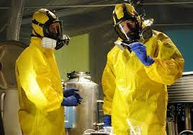
Respiratory Protection
Used to protect against the inhalation of vapors, gases, dusts, mists, respiratory pathogens, or other particulates.
Respirators are recommended and used based on the hazard.
Contact EHS for consultation on respirator selection.
Medical clearance is required for individuals using respirators.
Respiratory fit testing is required for N-95 and tight fitting respirators.

Slide 9
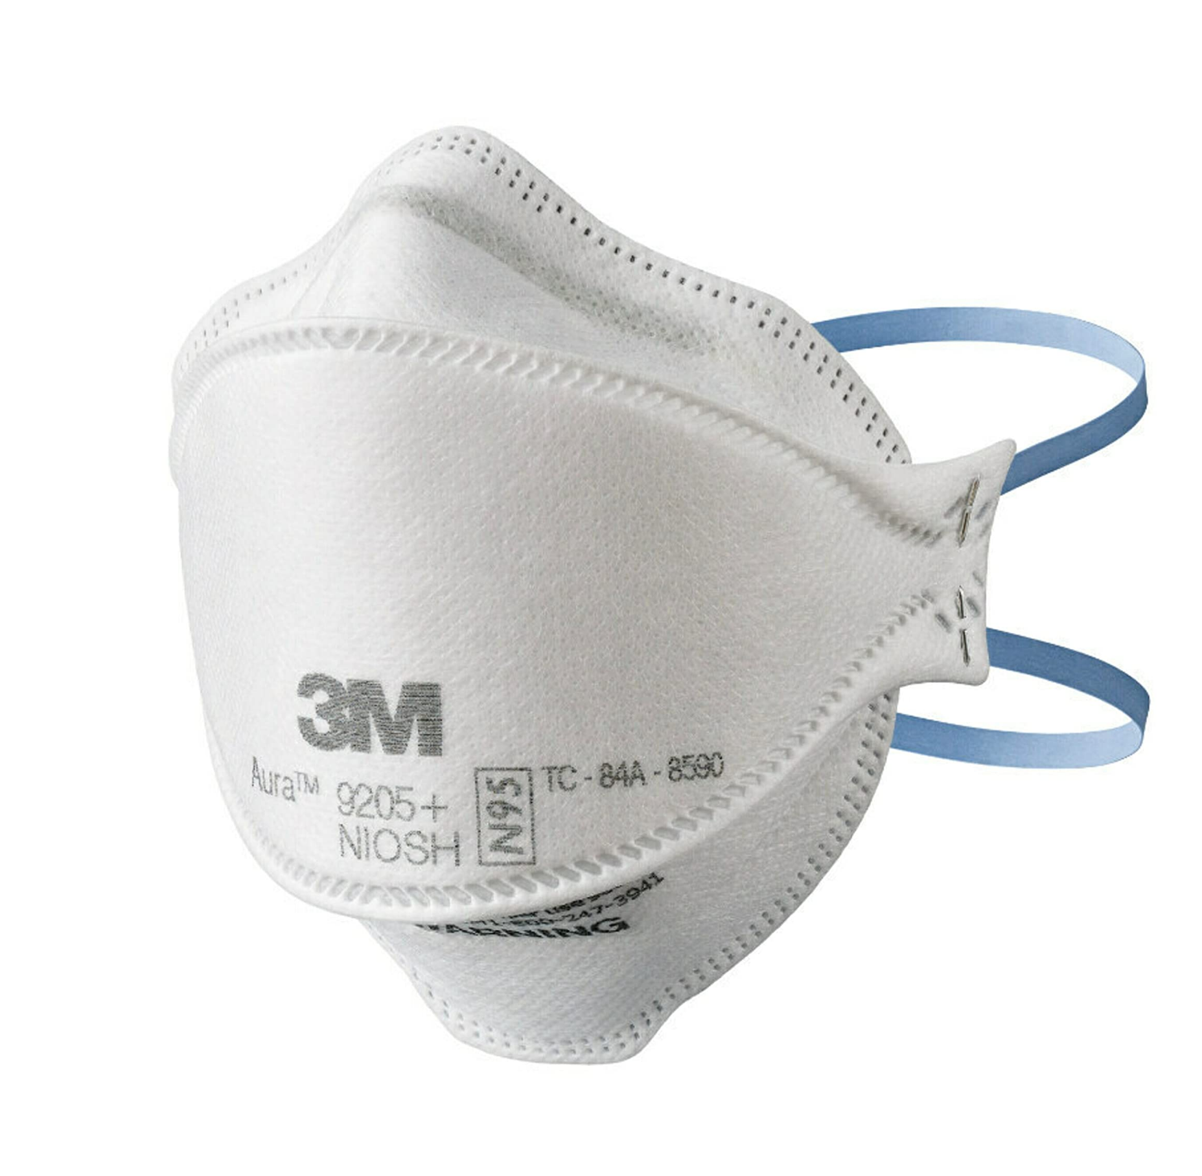
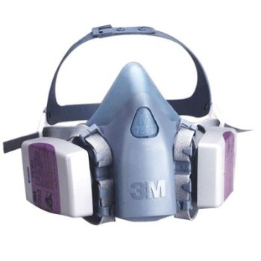
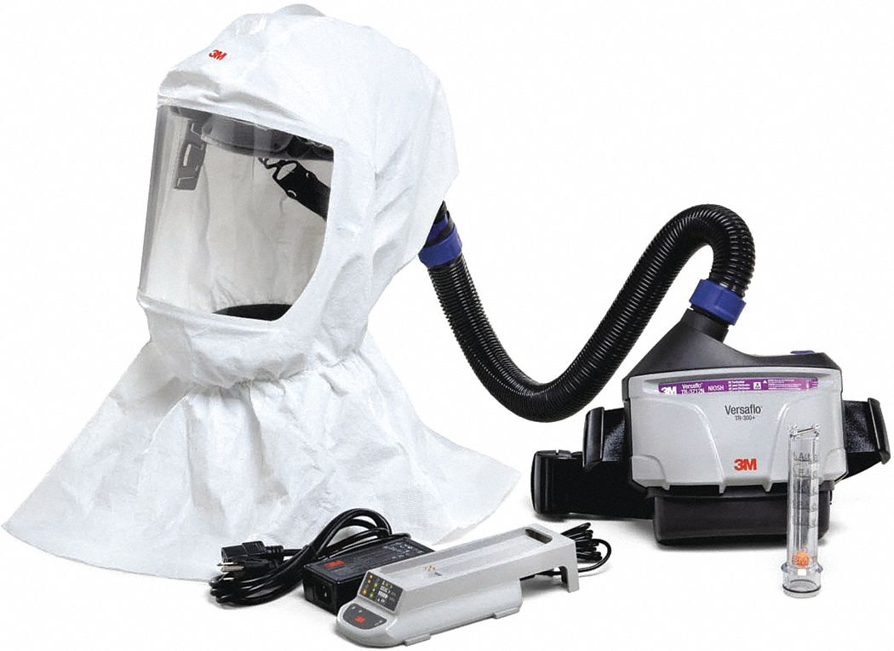
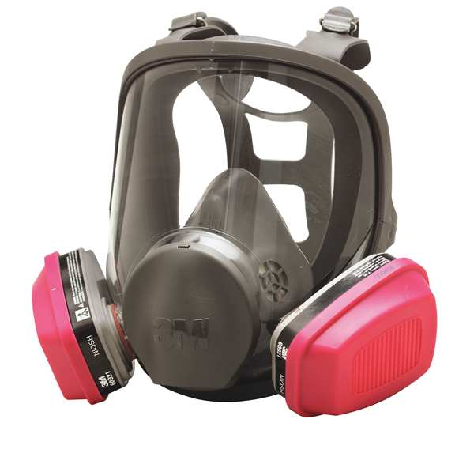
Types of Respirators
Disposable
Filters out particles (dust, mists, fumes)
Does NOT protect against gases or vapors
Includes N95 masks
Half-Face
Covers nose and mouth to protect against gases, vapors, and particles
Use appropriate cartridge or filter
Reusable
Full-Face
Covers face and eyes to protect against gases, vapors, and particles
Use appropriate cartridge or filter
Reusable
Powered Air Purifying Respirator (PAPR)
Circulates filtered air into contained headgear
HEPA filtered

Slide 10
Foot Protection
Shoes which completely cover the foot must be worn in the laboratory at all times.
  No sandals, flip flops, or slides!
  No crocs with holes!
  No flats, heels, or other shoes that expose the top of the foot!
Shoe covers may be necessary in certain areas to prevent cross-contamination.
Work-appropriate shoes can also protect you from physical hazards, spills, or splashes.

Slide 11
Appropriate Lab Attire
Allowed | Not Allowed | Explanation
Long pants | Shorts, capris, or skirts | Chemicals splash up after they hit the floor; shattered glass bounces up and can inflict injury on unprotected skin.
Shirts/tops that cover upper torso | Cropped shirts | Clothing covering the entire upper torso provides a layer of protection against spills and splashes.
Completely enclosed shoes that cover the instep of the foot | Sandals, open toe, open back, shoes with holes in the top or sides. | Shoes need to protect the wearer from chemicals, hot liquids, and shattered glass. Cloth shoes can absorb chemicals and hold them against the skin.

Slide 12
Work-Specific PPE
Chemicals/Radioactive materials:
Lab coat, gloves, eye protection, and appropriate shoes
Cryogenic liquids:
Cryogenic gloves to protect hands
Safety glasses, goggles, face shield to prevent splashes into eyes
  Materials can rapidly expand after removal from deep temperatures and may cause tubes to explode unexpectedly!
Pathogens:
BSL3 and Select Agent facilities may require use of coveralls, double layers of gown/shoe covers/gloves, and respiratory protection (N95 face masks or Powered Air Purifying Respirators (PAPR))
  Personnel should should consult their biosafety protocols.

Slide 13
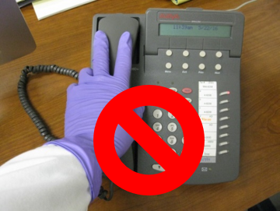


Common PPE Violations
Glove use outside of the lab
Not wearing safety glasses
Not wearing a lab coat
Reusing gloves
Wearing open toed shoes

Slide 14
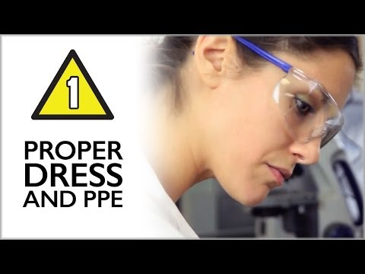
https://www.youtube.com/watch?v=GjAD83B4JaY&t=49s

Slide 15
Help Us Keep Everyone Safe!
Remind those that are not wearing appropriate PPE to please do so, for everyone’s sake!
Report safety concerns to:
Lab Supervisors
Principal Investigators
Building Managers
EHS
Please note: Principal Investigators are responsible for providing PPE and ensuring appropriate use.

