Slide 1
Saint Louis University
Engineering Controls

Slide 2
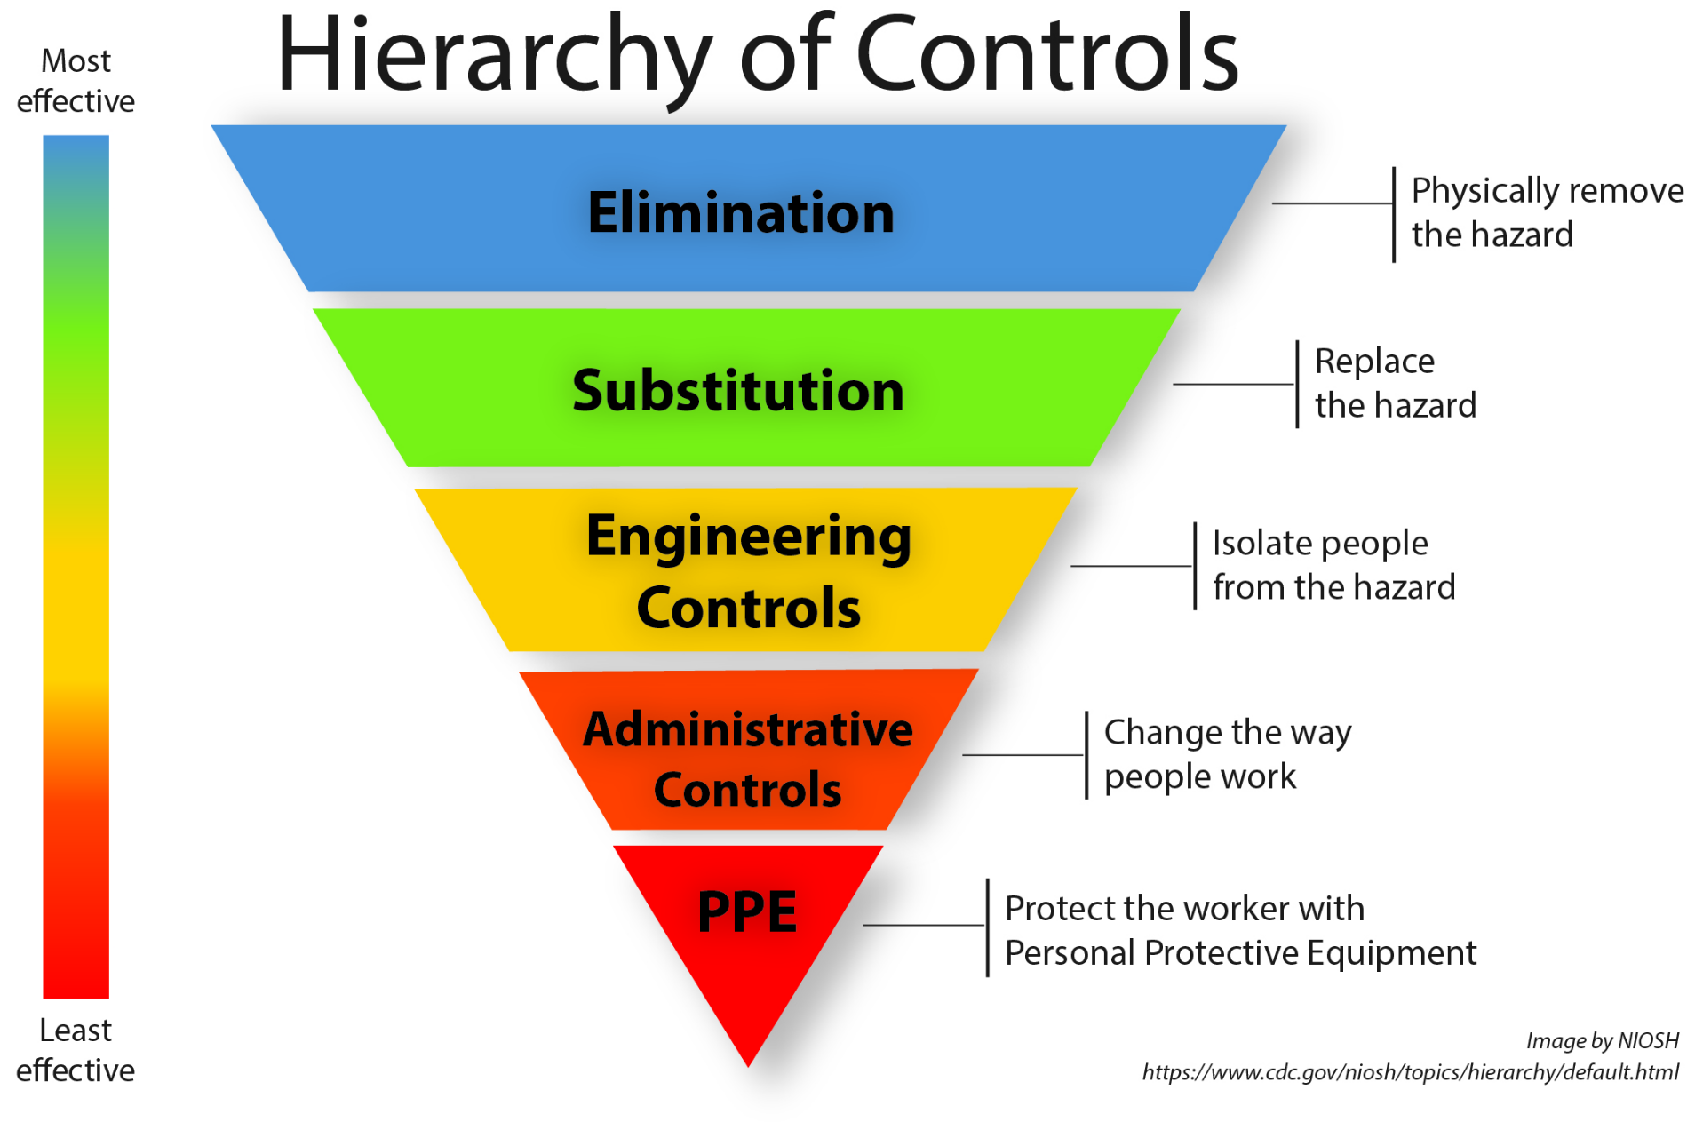
What are Engineering Controls?
If a hazardous material cannot be eliminated or substituted, engineering controls are the first line of defense to isolate people from the hazard.
See February 2023 Safety Awareness Training!

Slide 3
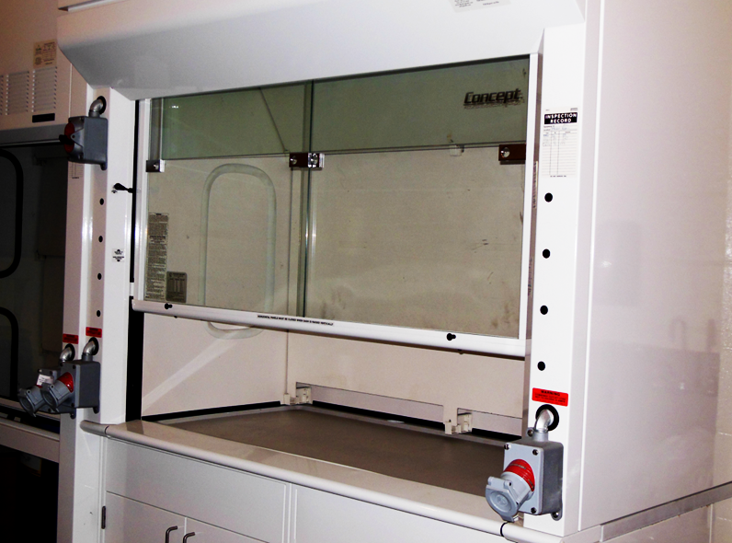
Chemical Fume Hoods
Used to contain and exhaust hazardous fumes, gases, vapors, or dusts.
Should be kept clean and clear of items that may impede proper air flow and normal operation.
Tested by EHS annually to ensure they are working properly. This includes:
  Linear face velocity measurements
  Visual inspection for excessive clutter
Chemical fume hoods used for volatile radioactive materials are tested quarterly.

Slide 4
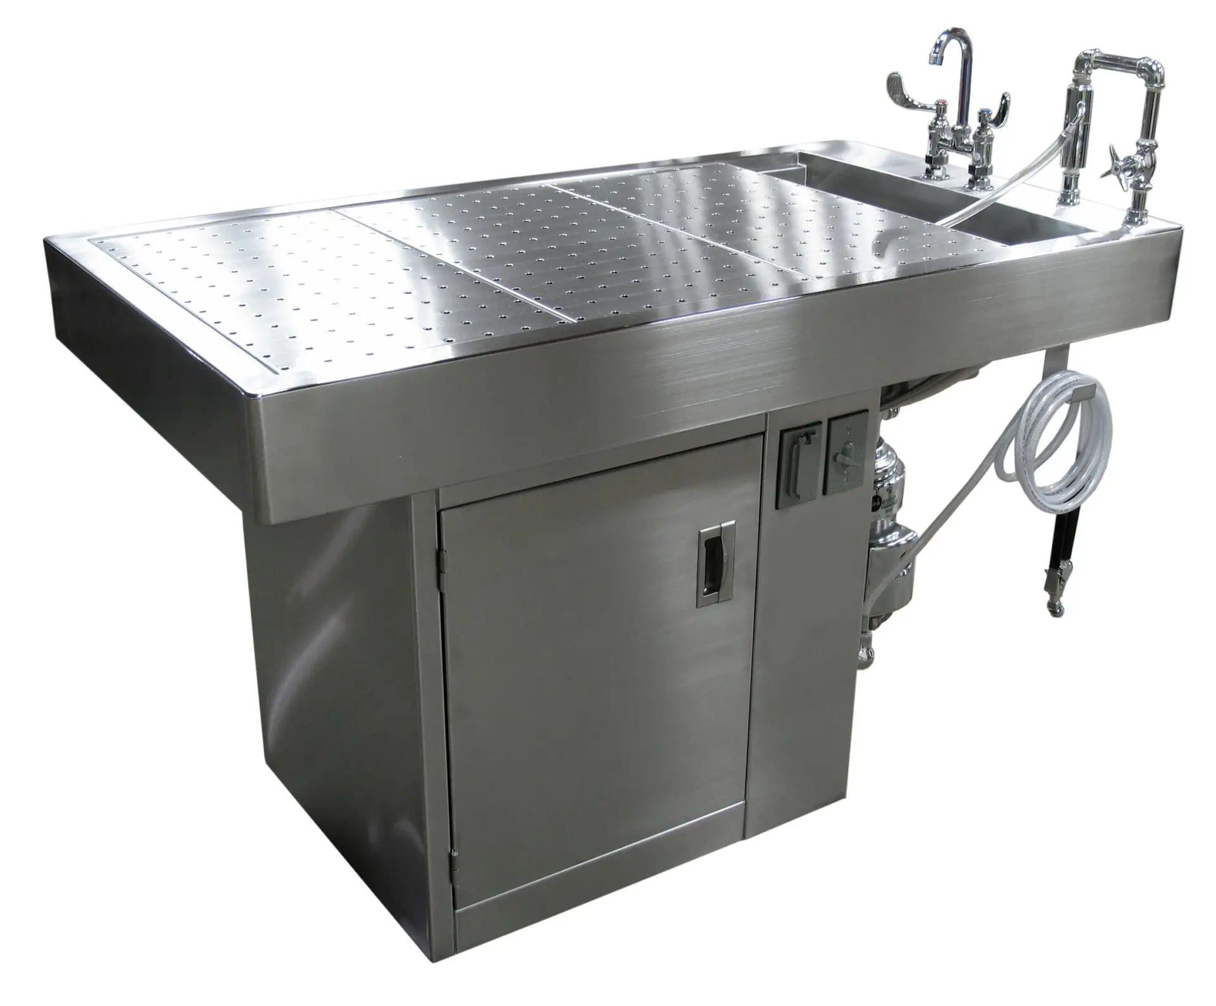
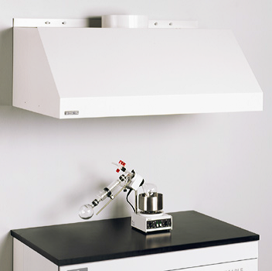
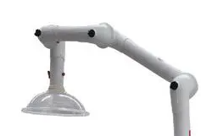
Downdraft Tables and Canopy/Portable Fume Exhausts
Downdraft Tables:
Provide ventilated work surfaces
All stainless steel construction
May include electrical receptacles and/or sink spray assembly
Canopy Hoods:
Designed to vent non-toxic materials such as heat, steam and nuisance odors.
Portable Fume Exhaust:s
Useful for laboratory benches when fume hoods are not an option.

Slide 5
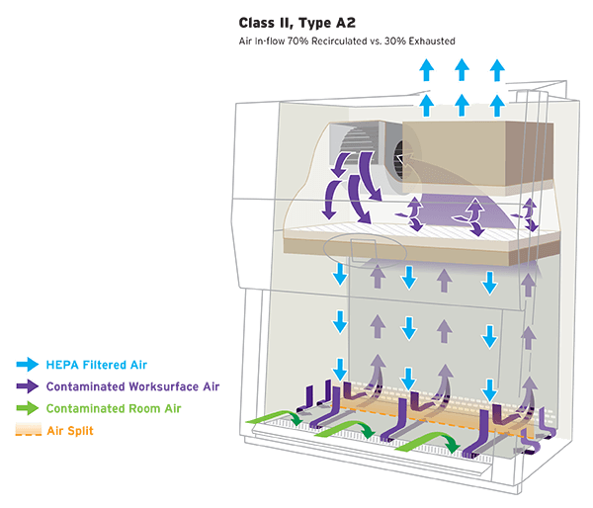
Biological Safety Cabinets (BSC)
When used properly, BSCs help protect users from exposure to biological agents.
BSCs work by providing an air curtain (vertical laminar airflow) between the user and the work environment.
Air is moved through a HEPA filter before recirculation within the cabinet or exhausted back into the room or into a permanently connected exhaust duct.

Slide 6
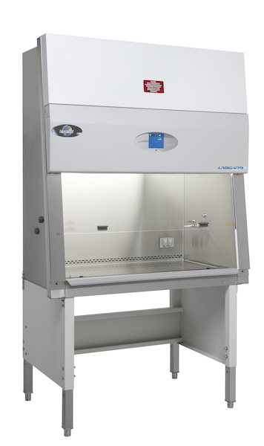
Biological Safety Cabinets (BSC)
BSCs must be tested and certified:
  At the time of installation
  Annually
  Any time they are moved
Do not use flammable gases in BSCs.
Keep vents clear of tools, etc (prevents proper airflow).
BSCs are not a storage location.
  Remove items that are not necessary for the tasks of the day
Use an appropriate disinfectant after each use.
Contact EHS with any questions regarding purchase, testing, or use.

Slide 7
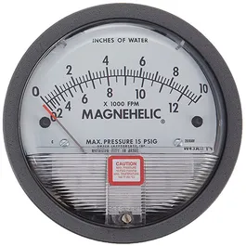
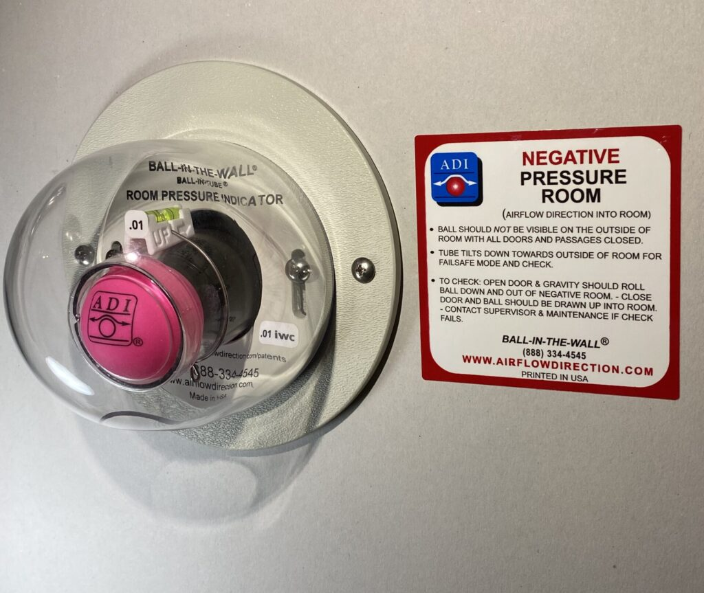
HVAC Design - Doisy Research Center
HVAC system is monitored using Metasys Building Automation Systems (BAS).
BSL-2 labs are single-pass, non-recirculating with 100% supplied outside air.
BSL-3 labs and ABSL3 facilities have negative directional airflow.
  Fresh air enters and exits the A/BSL-3 spaces through air supply ducts and exhaust ducts.
  Exhaust air passes through a HEPA filter bank and is dispersed from the roof via strobic fans.
  Relative air pressures are displayed near entrances using:
    Magnehelic gauges (measurement of directional airflow)
    Ping pong ball system (visual indicator of directional airflow)
  Red strobe lights are a visual indicator of an air handling failure.

Slide 8
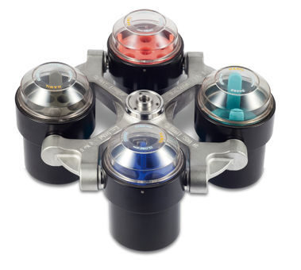
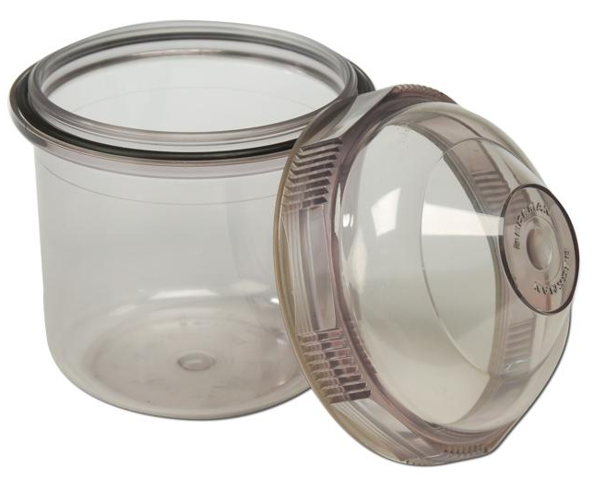
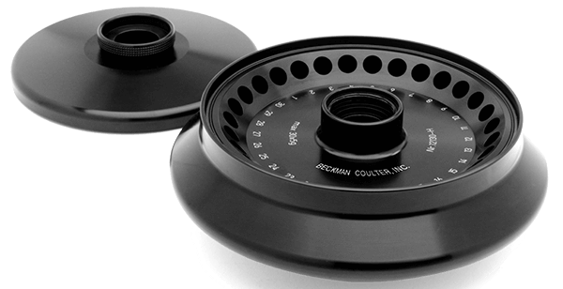
Centrifuge Rotors and Bucket Covers
Safety centrifuge cups and rotors with O-Rings contain spills and prevent release of aerosols during centrifugation.
  Check O-Rings and grease seals with vacuum grease.
  Use an approved disinfectant to decontaminate rotors/buckets after use. Use mild detergents for cleaning.
  Look for signs of corrosion. Metal fatigue will eventually cause any rotor to fail.
  Always use rotor(s) specified by the manufacturer.
  Ensure tubes are properly balanced in rotors.
O-Rings

Slide 9
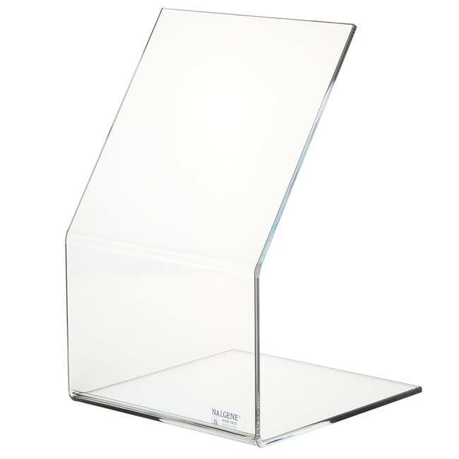
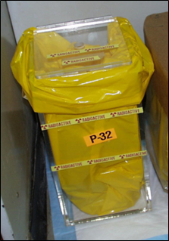
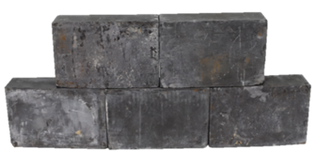
Shielding for Radioactive Materials
Plexiglass shielding for strong (energetic) beta emitters
Lead shielding for gamma emitters

Slide 10
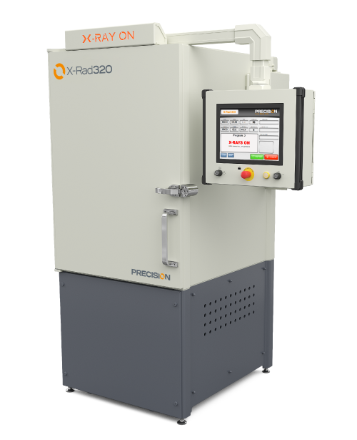
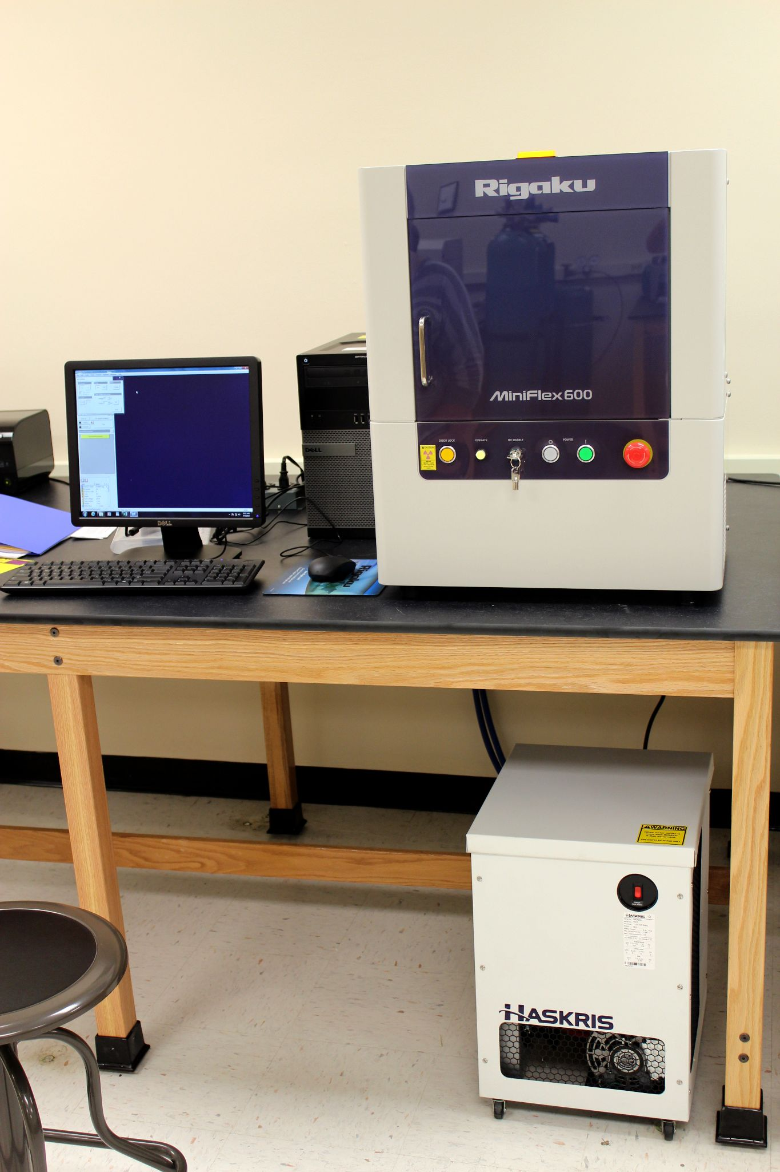
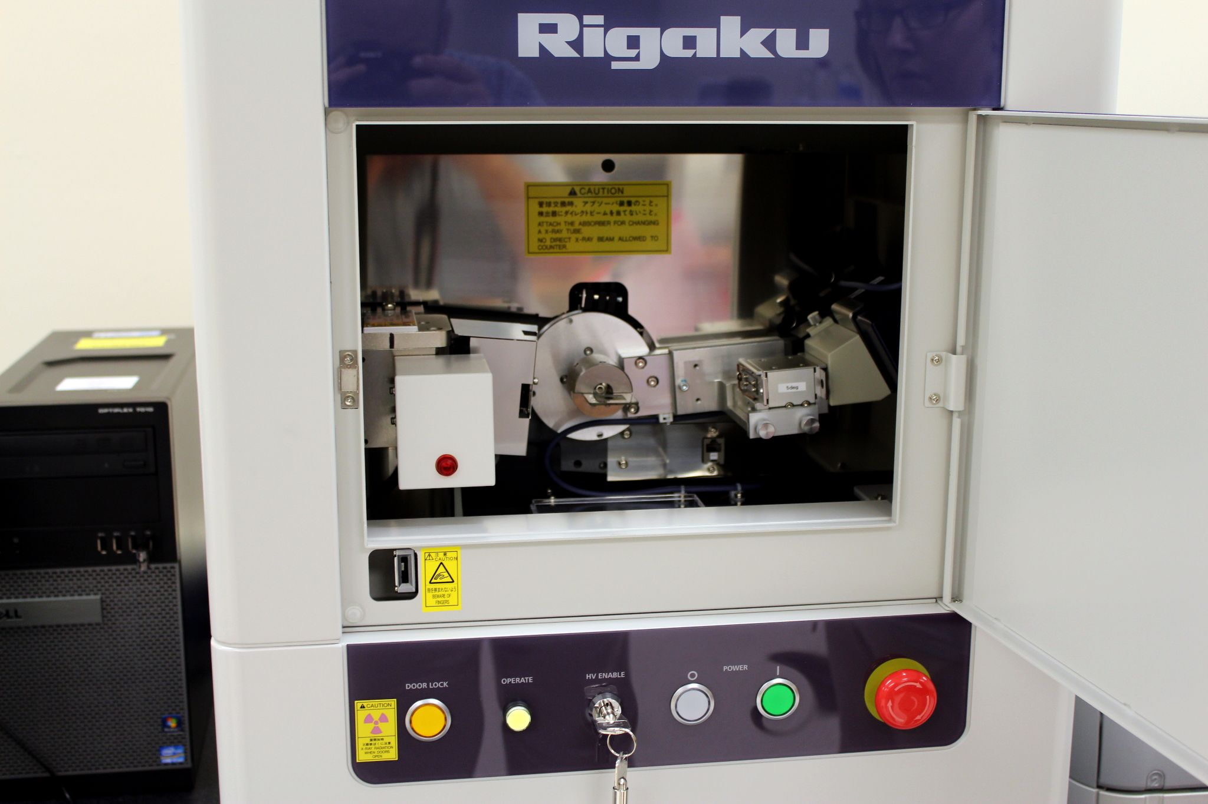
Self-Shielded X-Ray Cabinets with Door Interlocks
These cabinets are manufactured with shielding materials built into them.
Door interlocks are also built in to prevent personnel from being exposed to x-rays. If the door is opened, the unit stops emitting x-rays.

Slide 11
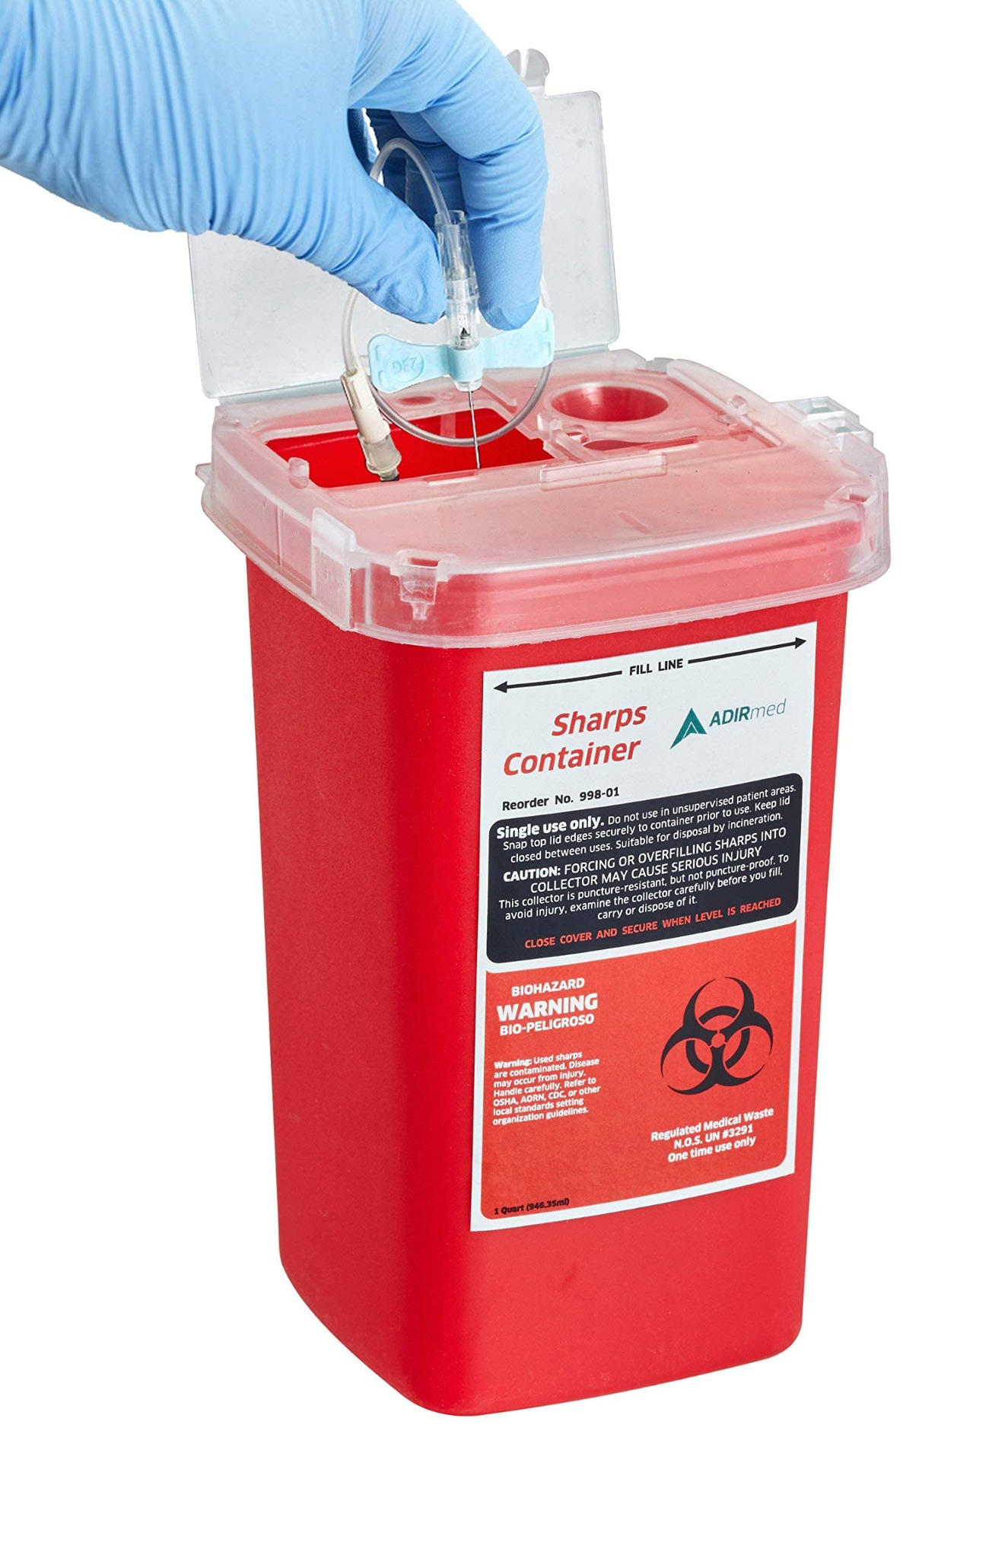
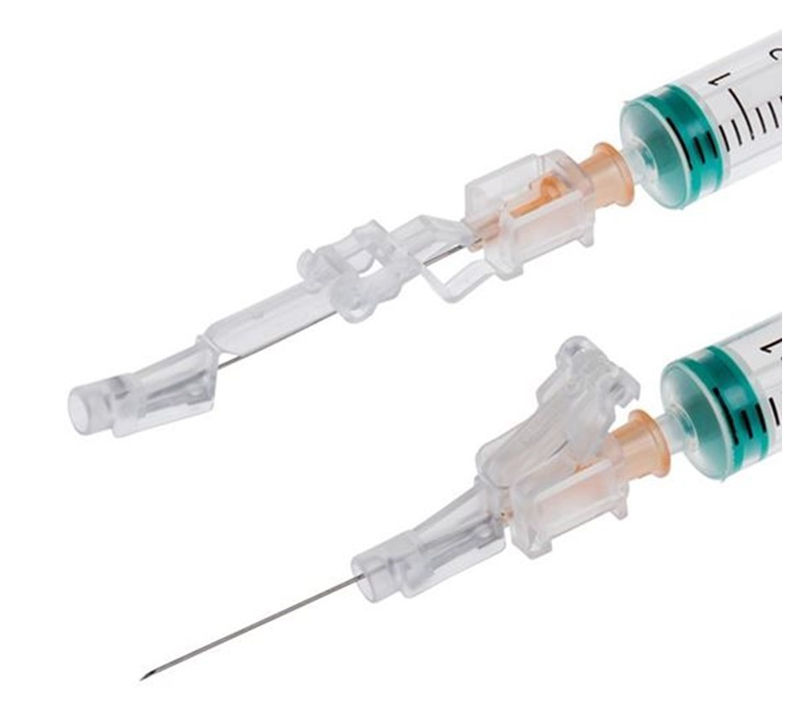


Safety Needles
Use self-sheathing needles and/or self-blunting needles,
  Eliminate or minimize employee exposure
Dispose of all sharps in leak-proof and puncture-resistant Sharps Disposal Containers.

Slide 12
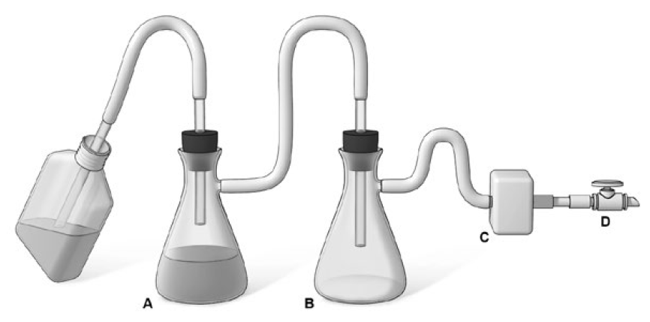
Vacuum Systems
If using with biological agents, the primary flask should contain sufficient volume of disinfectant (e.g. bleach) to decontaminate the final amount of liquid.
An in-line HEPA filter must be used between the final flask and the vacuum source to protect the vacuum from contamination!
HEPA
Protection of a house vacuum
Example method to protect a house vacuum system during aspiration of infectious fluids. The suction flask (A) is used to collect the contaminated fluids into a suitable decontamination solution; the right flask (B) serves as a fluid overflow collection vessel. An in-line HEPA filter (C) is used to protect the vacuum system (D) from aerosolized microorganisms.
(Adapted image/text from Biosafety in Microbiological and Biomedical Laboratories (BMBL) 6th Edition)

Slide 13
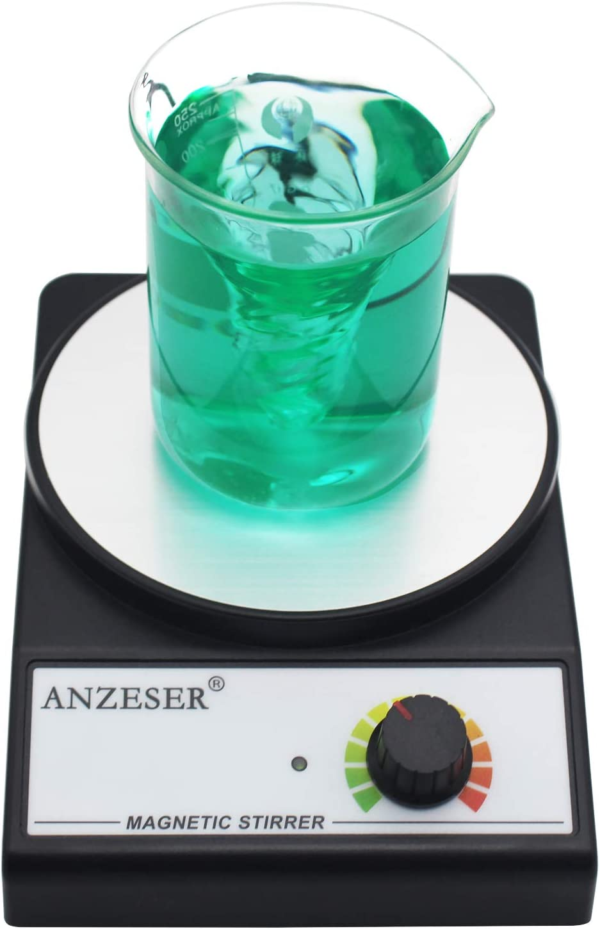
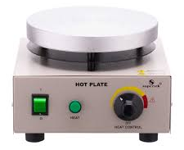
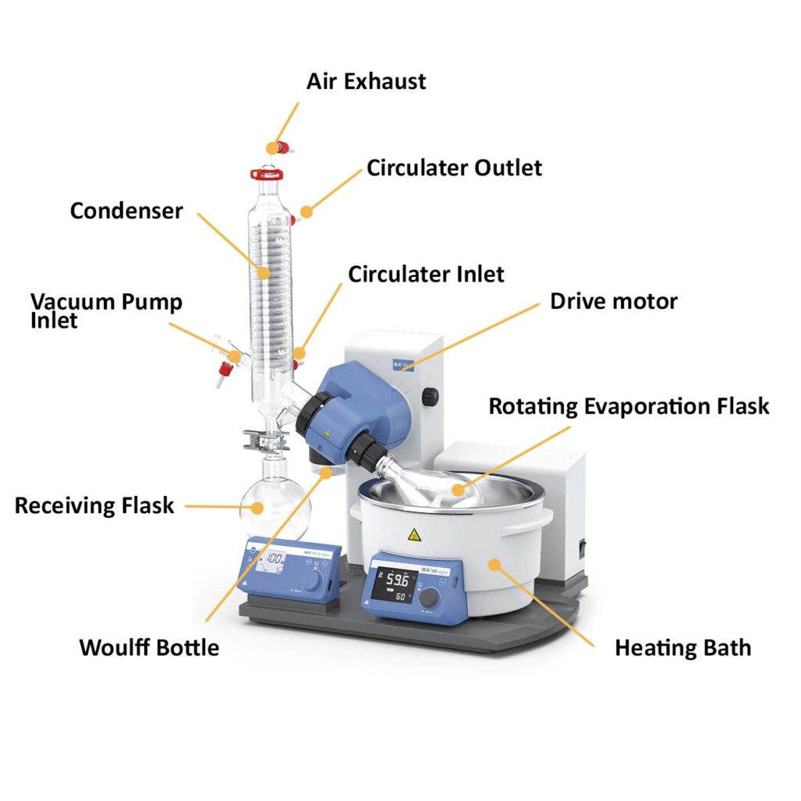
Hot Plates and Stirring Devices
Hot Plates:
Use in place of an open flame
Do not operate near volatile or flammable materials
Do not use with a metal vessel
Must be used within a fume hood if potentially hazardous vapors will be generated
Stirring Devices:
Operate in a biological safety cabinet whenever possible
Use spark-free induction motors in power stirring and mixing devices
Hot plate
Stir plate
Rotary Evaporator

Slide 14
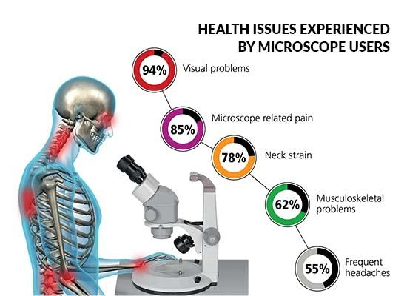
Ergonomics
Microscopes
Position microscope near the edge of the table
Use a height adjustable chair
Eyepiece should be at eye level

Slide 15
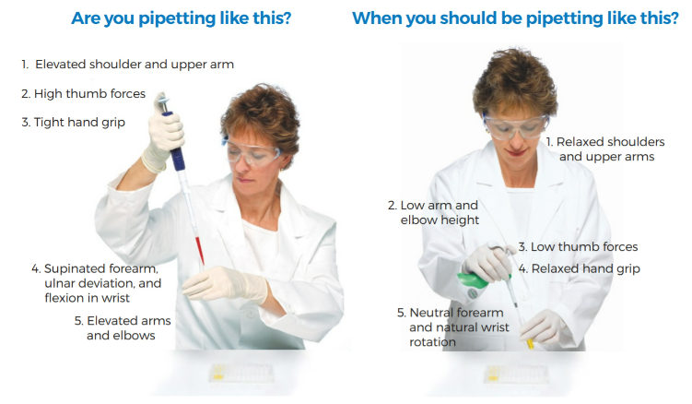
Ergonomics
Pipettes
Maintain straight wrists. Do not twist or rotate your wrists while using the pipette.
Keep elbow and body close to your work.
Select the lightest pipette that can fit in your hand comfortably.
Use multi-channel or electronic pipette to reduce repetitions.
https://vistalab.com/ergonomics-is-a-science-not-a-slogan/

Slide 16
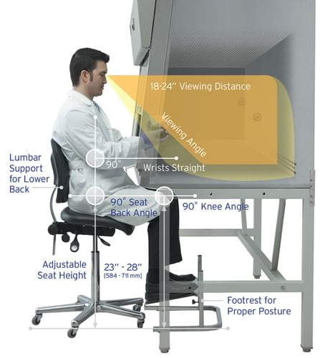
Ergonomics
Biological Safety Cabinet
Avoid repetitive movements whenever possible. Utilize ergonomic accessories.
Keep head bent forward at 30° angle or lower.
Rest elbows or forearms on elevated pads. Take care to not block front air grill or rest arms directly on work surface.
Avoid clutter and reaching across the work zone. Work from “clean to dirty”.
Keep wrists in-line with forearms - straight, non-locked position. Sit upright at 90° angle while working in the cabinet.
Take frequent breaks with periodic stretching.
Keep upper arms & shoulders relaxed whenever possible.

Slide 17
Summary
Please complete the Safety Awareness Quiz on Engineering Controls by May 31, 2023.
Please contact ehs@slu.edu for any questions.

