Slide 1
Saint Louis University
Training for Laboratory Personnel

Slide 2
Overview of Required Laboratory Training
The following trainings may be required for laboratory personnel:
  Laboratory Safety & Compliance Training (LST)
  Laboratory Specific Training
  Lab-Specific Biosafety Training
  Bloodborne Pathogen Awareness Training (BBP)
  BSL-3 Facility Awareness Training
  Animal Care Mandatory Training and Orientation (provided by CM)
  Animal Biosafety Training (provided by CM)
  Radiation Safety Orientation
  Shippers Training (Biohazards, infectious agents, dry ice, etc.)
Only those with up-to-date training are allowed to work in the laboratory.

Slide 3

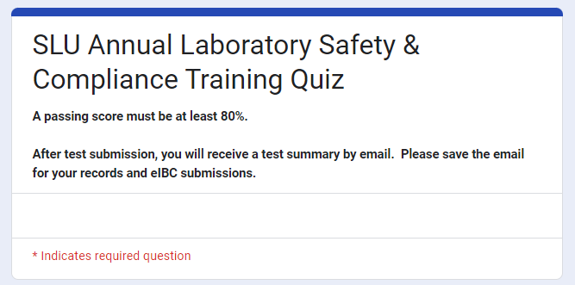
Laboratory Safety & Compliance Training (LST)
For all laboratory personnel (principal investigators, research faculty, staff, students, and volunteers).
Covers general safety, chemical safety, biological safety and local, state and federal compliance requirements.
Required annually.
Review the training slides and complete the LST quiz.
This training does not issue a certificate. Please retain a copy of your quiz summary for your records and eIBC submissions.

Slide 4
Laboratory Specific Training Outline
For all laboratory personnel (faculty, staff, students, and volunteers).
Ensures all lab personnel are aware of the locations of safety information and emergency equipment (Chemical Hygiene Plan, SDS, first aid kit, etc.), proper waste disposal, and lab specific SOPs and trainings.
Required upon initial hire, any time lab space is changed, or any time a new significant hazard is introduced.
Labs may use the EHS Laboratory Specific Training Outline or develop a similar form using this as an outline.

Slide 5
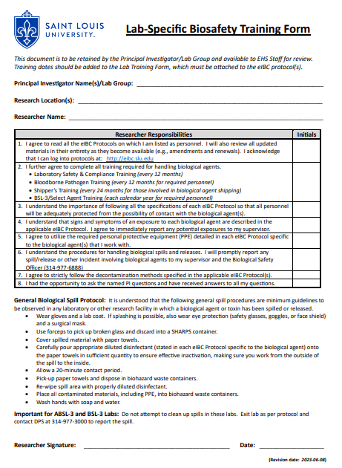
Lab-Specific Biosafety Training
For all laboratory personnel listed on eIBC protocols.
Reminds personnel to:
  Read all applicable eIBC protocols and follow listed specifications.
  Complete all required trainings.
  Understand the signs and symptoms of exposure and report all potential exposures to their supervisor.
  Wear the approved PPE in each eIBC protocol.
  Understand the procedures for biological spills/releases and how to report them.
  Follow decontamination procedures.
Available in eIBC, or via email (Patricia.Osmack@slu.edu)

Slide 6
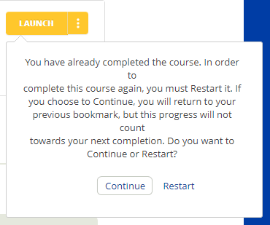
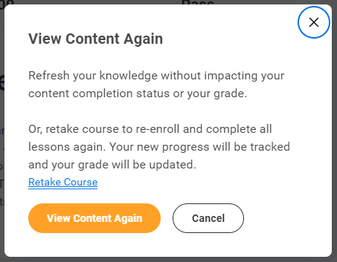
Bloodborne Pathogen Awareness (BBP)
For individuals who may come in contact with human blood, human or non-human primate cell lines, or other potentially infectious materials (OPIM) as a part of their jobs.
Required annually.
Can be accessed through Skillsoft or the “Learning” tab in Workday.
Note: You must click “Restart” or “Retake Course” to record your new training date.

Slide 7
BSL-3 Facility Awareness Training
For all personnel accessing and working in BSL-3 laboratory facilities.
Provides an overview of facility and security parameters, general facility functionality, and workers responsibilities.
Required yearly (each calendar year).
Note: PAPR (Powered Air-Purifying Respirator) training may also be required yearly for those working with respiratory pathogens.
Contact Christopher Eickhoff (314-977-6888 or christopher.eickhoff@health.slu.edu) to schedule training.

Slide 8
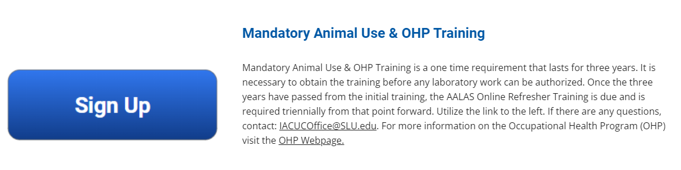
Animal Care Mandatory Training and Orientation
For all personnel prior to working with laboratory animals.
Offered by Comparative Medicine and OHP Manager.
Initial in-person training, followed by online refresher every 3 years.
Follow link to IACUC Personnel and Training Portal to register for training.

Slide 9
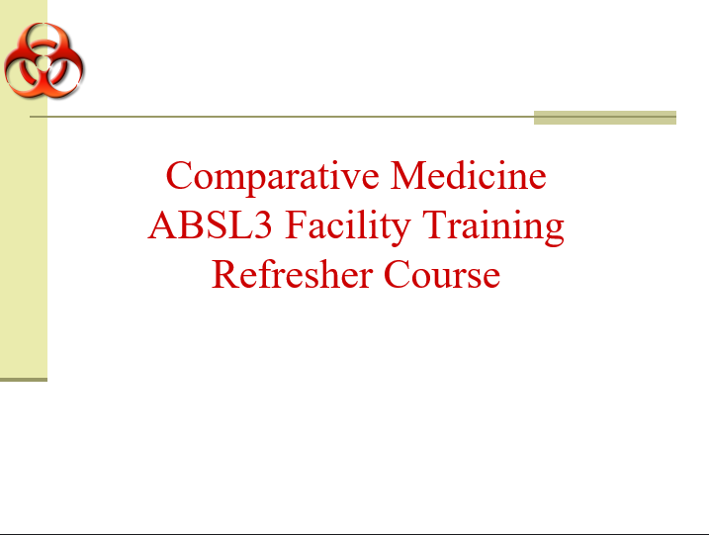
Animal Facility Biosafety Training
For all personnel working with biological agents in animals within ABSL2 or ABSL3 facilities.
Offered by Comparative Medicine.
Covers loss of containment, accidental exposures, spill procedures, PPE, facility safety parameters, and emergency contact information.
Initial in-person training with annual refresher.
Contact Frank Speck (314-977-5437 or frank.speck@health.slu.edu) to schedule training.

Slide 10

Radiation Safety Orientation
For all laboratory personnel prior to working with radioactive materials.
Individuals that work in laboratories where radioactive materials are used but who do not directly use radionuclides are also encouraged to attend.
Contact Kevin Ferguson (kevin.ferguson@slu.edu) to schedule training.

Slide 11
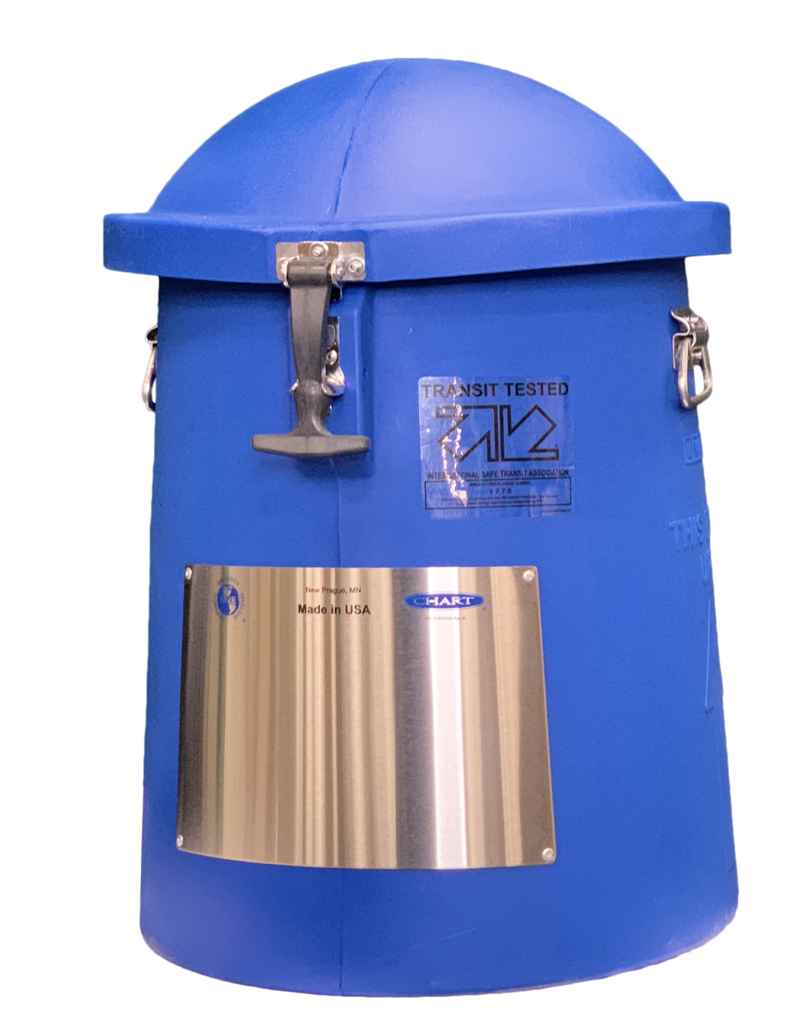
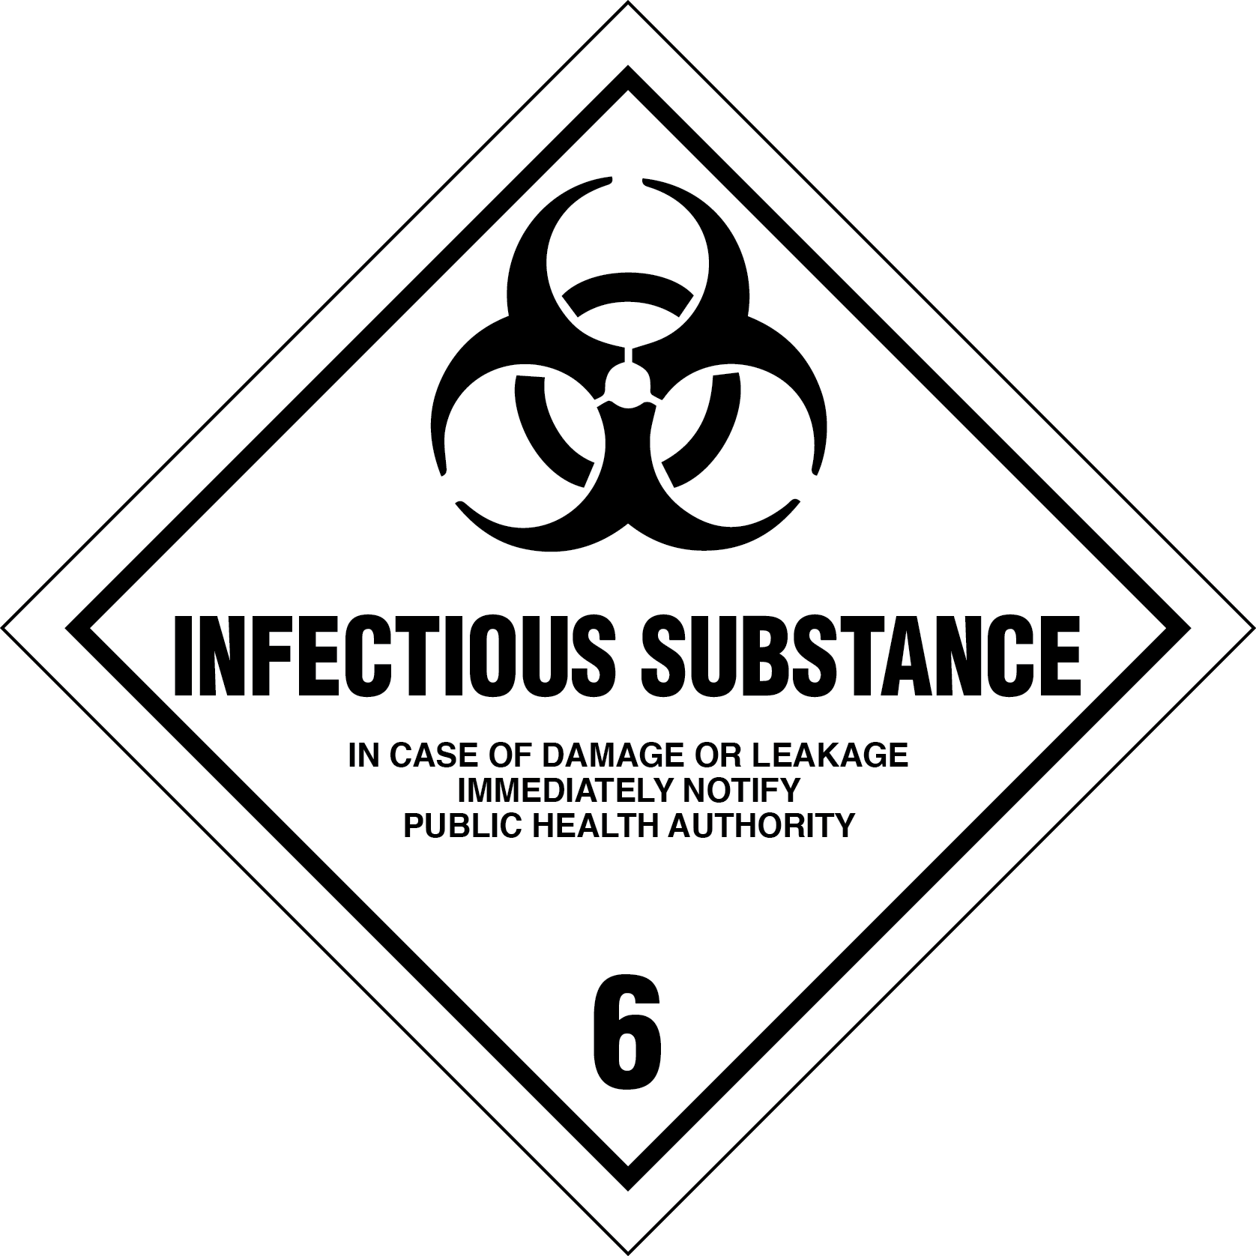

Shippers Training (DOT / IATA)
For personnel who package or ship hazardous materials.
  DOT training for shipping by ground.
    Four modules - required every 3 years
  IATA training for shipping by air.
    Five modules - required every 2 years
Both can be accessed through Skillsoft or the “Learning” tab in Workday.

Slide 12
Summary
The PI is responsible for ensuring that all personnel have completed all relevant trainings.
Training records should be maintained in the laboratory and accessible to laboratory personnel and during internal or external inspections.
More information on these trainings can be found on the Training tab of our website.
Contact ehs@slu.edu for any questions regarding training.
Please complete the Safety Awareness Quiz on Training by August 31, 2023.

