Slide 1

Business Manager Meeting
September 9, 2021

Slide 2
Announcements
    Future Business Manager Meetings
      Submit topics of interest to budgetoffice@slu.edu
      December 9, 2021
    Women’s Commission Virtual Auction
      Support the Sister Shirley Kolmer Memorial Grant
      Monday, September 13 through Friday, September 17

Slide 3
Agenda
  Human Resources
    Vitality Discontinuation
    Contacting HR/Workday Support
    Department of Labor Compliance – Candidate Dispositioning in Job Requisitions
    Labor Reallocation Form Submission Process
  Business & Finance
    Budget Amendment Policy and Job Aid
    Personnel Budget Amendment Example
    Workday Report Changes
    Travel Updates
  ITS
    NEW Information Security Awareness Program
    Windows 7-10 Migration & Dell Ordering

Slide 4
Human Resources

Slide 5
Vitality Discontinuation
2022 Premium Discount: Employees will still be eligible to receive a medical premium discount by obtaining a biometric screening (i.e. blood draw) in the fall.
  SLU will continue to provide access to biometric screenings through Quest Diagnostics for the fulfillment of this requirement
  Completion of the Vitality Health Review (i.e. online questionnaire) will not be required during fall 2021 for the 2022 premium discount
Vitality Points: Access to the Vitality platform will end on Sept. 30, 2021, and any unused points will expire on that date.
  Members are encouraged to submit any points-earning activities or gym rebates by Sept. 15, 2021 to allow processing time
  Points can be used to purchase Amazon gift cards, fitness devices and much more
  Vitality points can be redeemed at https://www.powerofvitality.com/vitality/login

Slide 6
Contacting HR/Workday Support
Job Aids should always be leveraged first (when applicable).
General HR Inquiries: HR@slu.edu
  Examples: I-9 Questions, Employment Verification, Address Updates, General Workday Navigation, Policy Questions, Hire Date Changes, Misc. Inquiries
Benefits Inquiries: benefits@slu.edu or 314-977-2595
  Examples: Life Event Changes, Tuition Remission, Benefit Related Deduction Questions, FTE Changes (Benefit Impact)
  Vendors may need to be contacted directly for certain examples (Ex. TIAA must be contacted directly to request an account rollover)
Payroll Inquires: Payroll@list.slu.edu
  Examples: FNTIF (International Tax Payroll Paperwork), Registering in a new state for Remote Work
Compensation Inquiries: Comp@slu.edu
  Examples: Merit Inquiries, Job Description Inquiries
HRIS (Workday) Inquiries: HRIS@slu.edu
  Examples: Sup Org Issue, Delegations, Reporting Requests
Learning + Development Inquiries: Training@slu.edu
  Examples: Skillsoft/Training Material Inquiries, Cura, Feedback Survey
FMLA: fmla@slu.edu, 877-462-3652, or www.fmlasource.com
  Examples: Medical Leave, Parental Leave, Accommodations

Slide 7
Department of Labor Compliance –
Candidate Dispositioning in Job Requisitions
The Department of Labor (DOL) recognizes Saint Louis University as a federal contractor.
Under the Office of Federal Contract Compliance Programs (OFCCP), the University has a mandatory obligation to comply with the legal requirement to take affirmative action and not discriminate on the basis of race, color, sex, sexual orientation, gender identity, religion, national origin, disability, or status as a protected veteran.
Subject to government audits that review mandates that extend to our entire workforce, including job applicants, and encompasses all personnel activity such as hiring, promotions, terminations, and compensation.
Hiring Managers, Business Managers, and Search Committee Chair Users are responsible for ensuring that the University adheres to its affirmative action obligations in our application and hiring processes.

Slide 8
Thoughtful Candidate Dispositioning
What is candidate dispositioning?
  The process of moving a candidate along in the hiring process, or removing them from consideration.
All applicants have been assigned the proper applicant disposition code (i.e., the reason why each individual applicant was/was not accepted to advance through the hiring process.
All steps, or stages, along with the disposition reason code must be captured in Workday for all applications.

Slide 9
Thoughtful Candidate Dispositioning
Please take special care to accurately document the reason why each individual job applicant has/has not been selected for screening, interviewing, or hiring. Examples where applicant disposition codes are commonly misused include, but are not limited to:
  Falsely misrepresenting that the applicant(s) applied too late for consideration, could not be contacted for an interview, or some other inaccurate reason for not providing due consideration to the applicant;
  “Mass dispositioning,” or inaccurately assigning the same disposition code to the entire applicant pool without giving due consideration to the actual reasons why each individual applicant did not move forward in the hiring process.
  Only assigning a disposition code to the applicant who was hired, providing no disposition codes for the remaining applicant and simply closing out the job requisition.

Slide 10
Thoughtful Candidate Dispositioning
Preselecting an applicant and refusing to interview other qualified applicants may constitute a violation of OFCCP guidelines. Steer away from 1:1 hiring.
If there are multiple qualified applicants, it will never be appropriate to proceed with hiring a candidate without interviewing other applicants.
As a reminder, all job requisitions must be posted for a minimum of three days. If you feel you have an adequate pool of applicants after this timeframe, please request that the position be unposted so that you do not continue to gather additional applications in your applicant pool.

Slide 11
Resources
Recruiting: Disposition Video
Recruiting: Manage and Disposition Job Aid
Recruiting Google Site

Slide 12
Labor Reallocation Process Improvements
Presented by Tammy Grant, MBA, Business Manager
IM-IDAI & Center for Vaccine Development

Slide 13
Key Changes
  Unique LR# generated by the originator.
  University-wide log to track forms through the approval process.
  All LR information housed within the same file.
  Approvals and routing via e-mail only.

Slide 14
Updates
  LRs will no longer be accepted on paper, or as PDFs-too difficult to read/update.
  Include the LR# and employee’s last name in the subject line of the approval e-mail.
  Save the file the same way LR#_Last Name.

Slide 15
LR Approvals
  No changes to who needs to approve, just how.
    P.I. (Principal Investigator) approval needed on grant funds
    Other P.I./other dept. approvals needed when there is a cross departmental collaboration
  Approvers need to remember to note “I approve” in the e-mail before forwarding on.
  Only send to next approval step, not all, and cc the originator.

Slide 16
Reminders
  When routing to the P.I. for approval, make sure you clarify the purpose for the transfer/the resultant changes in % effort.
  Remember to include a justification (i.e., how the incorrect entry happened in the first place, how expense relates to grant being charged, how future errors will be avoided).
  LRs tied to a single event (i.e., fixing an overspent award) should be attached to the same e-mail along with closeout calculations.

Slide 17

Any Questions?
Thank you to all who assisted with this process improvement

Slide 18
Business & Finance

Slide 19
Budget Amendment Policy
  Located at:
  https://www.slu.edu/business-finance/policies-procedures.php
  Purpose:
  Provide guidelines to correct overdrawn personnel or general expense pools in the ‘11 Operating Fund.’
  Move funding from Spend Categories (SC) or Spend Category Hierarchies (SCH) with available budget to SC or SCH with deficits.

Slide 20
Budget Amendment Policy
  Initiated at the Cost Center by the Cost Center Manager (i.e., the Business Manager in most cases).
  Revised ‘Create Budget Amendment for Organization’ job aid can be found in Workday.
  Budget Amendments should be rounded to whole dollars.
  All documentation/backup should be attached to the Budget Amendment in Workday.

Slide 21
Budget Amendment Policy
  Any new budget added (i.e., a one-sided amendment) or budget moving between executive levels/colleges/schools needs to be initiated by the Office of Financial Planning & Budget. Please email these requests to budgetoffice@slu.edu.
  Cost Center Managers should not adjust revenues (i.e., Revenue Categories or Revenue Category Hierarchies). These requests need to go through the Office of Financial Planning & Budget with approval from the CFO or President.

Slide 22
Budget Amendment Policy
  Budget is not permitted to move between an ‘ll Operating Fund’ and any other fund type (e.g., ‘24 Designated Unrestricted Fund’).
  Budget is not permitted to move between personnel and general expense SC or SCH unless previously approved and documentation is attached to the Budget Amendment.

Slide 23
Budget Amendment Policy
  All Full-Time and Part-Time personnel Budget Amendments are to have the corresponding fringe benefit entry.
    For example: A $10,000 increase to a FT Staff SC also requires a fringe benefit increase of $3,325, or 33.25% of $10,000, to the Fringe Benefits Allocated SC.
  Types:
    Permanent = ongoing need
    Temporary = only pertains to current fiscal year

Slide 24
Revised Job Aid
‘Create Budget Amendment for Organization’
  Finalizing the Ledger Account/Summary to Spend or Revenue Category/Hierarchy Crosswalk before it is placed in the library.
Applies only to the University Operational Plan which is the ‘11 Operating Fund’.
‘Create Position Budget Amendment for Organization’ is no longer relevant.
Fringe Benefits do not automatically calculate and will require manual entry.

Slide 25
Revised Job Aid
‘Populate Existing Budget Lines
    Worktags field – Enter Cost Center(s) to adjust
    Eliminates need to ensure Ledger Account/Summary and correct corresponding SC or SCH are chosen
Cost Center Managers can only enter Balanced Amendments
Katelyn will walk you through an example that adjusts the personnel budget between two Cost Centers

Slide 26
Workday Report Updates
Structured by Ledger Accounts (NEW)
  CR – FIN – Budget vs Actuals by Org
  CR – FIN – Budget vs Actuals by Org – SLUCare
  CR – FIN – Statement of Account
Structured by Revenue and Spend Categories/Hierarchies
  CR – FIN – Budget vs Actuals by Org FY21
  CR – FIN – Budget vs Actuals by Org – SLUCare FY21
  CR – FIN – Statement of Account FY21
  Note: For all reports you should be able to use the default Plan Structure and Plan Name. If you are having any issues and/or reports are not meeting your needs, please contact wdfinance@slu.edu.

Slide 27
Travel Updates

Slide 28
Interim Travel Policy
Effective July 1st, SLU approved an update to the interim travel policy, initially adopted in 2020 in response to COVID-19, which had suspended all non-essential University-sponsored travel including educational and professional conferences.
The update is intended to align with current guidance from the Centers for Disease Control and U.S. Department of State.

Slide 29
Interim Travel Policy Update
Policy Scope
Applies to all operating units of Saint Louis University including all faculty, staff, students, and trainees.
Does not apply to NCAA sport programs that travel for practice or competition.

Slide 30
Interim Travel Policy Update
The only remaining prohibition is University-sponsored travel to locations that fall under the U.S. Department of State’s Level 4: Do Not Travel advisory.
University-sponsored travelers must attest that they have been vaccinated against COVID-19 or will quarantine upon their return. Attestation messages have been built into the Workday and Concur travel processes.

Slide 31
Interim Travel Policy Update
What is considered University sponsored travel?
An individual will be representing the university.
The trip is organized on behalf of a registered university organization, including, but not limited to student organizations, religious groups, sports clubs, varsity teams, civic engagement organizations, academic or administrative departments.
A university account contributes funds, or money is held and disbursed through a university account.
The trip is organized by a university faculty or staff member.
The work will be considered for academic credit.

Slide 32
REAL ID
Beginning May 3, 2023, residents of every U.S. state and territory will be required to present a REAL ID-compliant drivers license or ID card, or U.S. Passport, to board federally regulated domestic flights.
All states are now able to issue REAL IDs. Apply early to avoid delays.
Additional documentation is required to apply for REAL IDs versus regular license or ID.

Slide 33
TravelPlex-SLU Account Rep
Kathleen Altepeter
314-569-1900

Slide 34
Helpful Links
Interim Travel Policy Update:
https://slu.policystat.com/policy/token_access/91462341-f074-4b80-b991-6af96246a628/
U.S. Department of State:
https://travel.state.gov/content/travel/en/traveladvisories/traveladvisories.html/
REAL ID:
Missouri - https://dor.mo.gov/driver-license/issuance/real-id/
Illinois - https://realid.ilsos.gov/

Slide 35
Contact
Questions for all things travel or Concur?
Contact
univtravel@slu.edu

Slide 36
ITS
  Cybersecurity Awareness

Slide 37

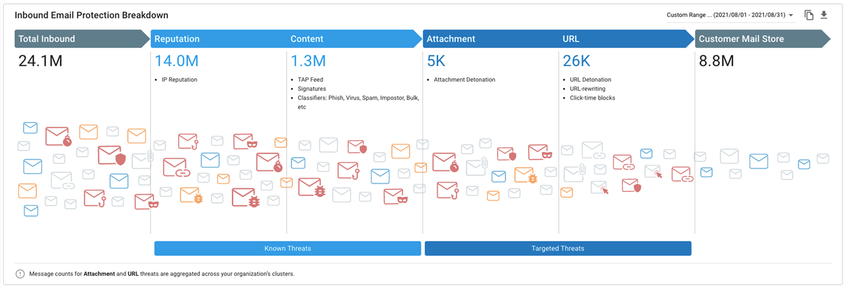
Combating Phishing @ SLU
(This is where we need your help)

Slide 38
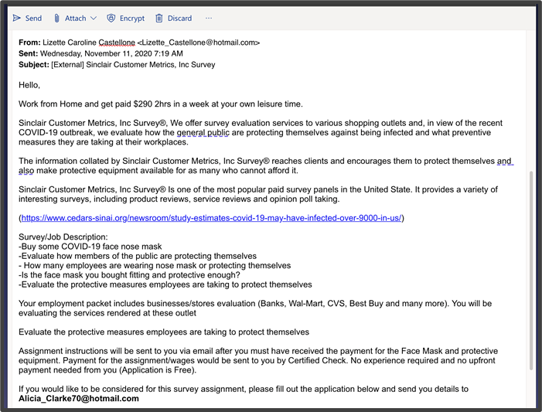
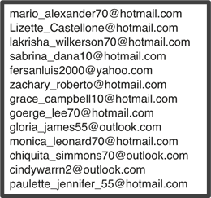
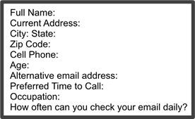
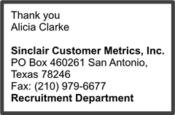
Phishing Attack Targeting SLU
Goal of Campaign
Solicit personal bank account info
Tactics to Avoid Detection
Well written/formatted
Sent to limited audience
Sent from multiple “clean” accounts (13)
Included link from well-known source (i.e. Red Herring)
“Tells”
Commodity email addresses (Hotmail, Yahoo)
Financial enticement – Low Effort, High Reward
Requested recipient’s “alternate” email address
Asked for reply to a different address than sender
Signed by different name than sender
No street address, web site, or phone number provided

Slide 39
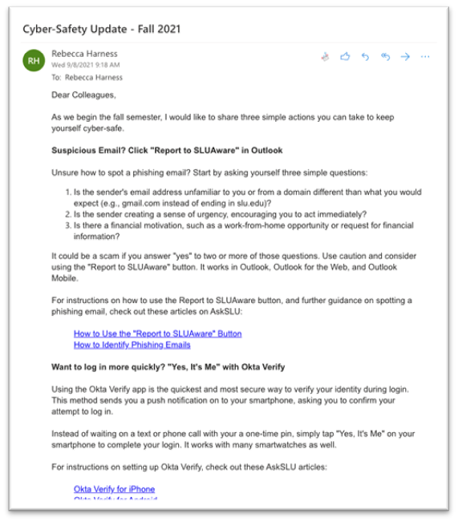
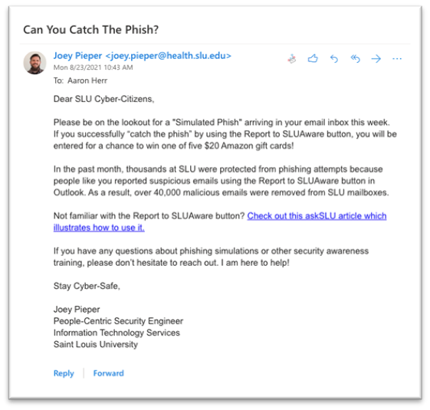
Increased Cyber-Safety Messaging

Slide 40
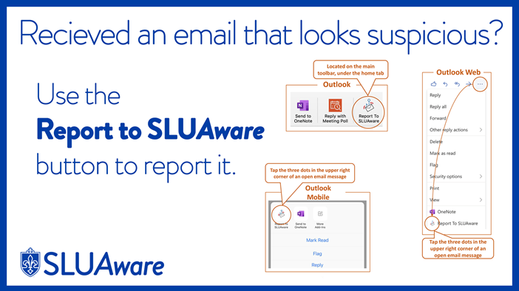

Coming Soon to Digital Signage Near You

Slide 41
Regis University Cyber Attack (2019)
Well Orchestrated Attack - Just Before Classes Started
Attacked Backups First. Started Encrypting Data Second
Investigation Unable To Determine Root Cause. Tracks Erased.
Digital Forensics Determined Nation-State Sponsorship
Financially Motivated (Ransomware)
After Months, Determined There Was No Data Breach
Regis Never Considered Themselves An Attractive Target
By January, They Had Recovered/Rebuilt 80% Of IT Services

Slide 42




What Can You Do To Help?
Start A Conversation About Cybersecurity
Stay Alert & Report Suspicious Activity
Participate In Security Awareness
Help Us
Help You
SLUAware@slu.edu

Slide 43
Thank You!

Slide 44

WINDOWS 7 TO 10 uPGRADE
(ITS) Information Technology Services 09/09/2021

Slide 45
Current State, Timeline
Approximately 6400 Workstation at SLU
As of today, 619 workstations remain on Windows 7
Approximately 10% of the total
Schedule:
  Deadline is *September 2021

Slide 46
What you need to know
Technology:
  Upgrade: Computers less than 4 years old (Dell)
  Replace: Computers over 4 years old (HP and others)
Costs
  Upgrades: $0
  Replacements:
    Standard desktop $600 (Monitor +$150)
    Standard laptop $1,000

Slide 47
What you need to do
  If you have not ordered new replacement hardware for machines older than 4 years old, please do so now.
  If a machine just needs an upgrade to Windows 10, please call us at 4000 or put a ticket in via ask.slu.edu.
  Currently Dell and many other laptop vendors are having trouble delivering stock quickly due to shortage of circuit boards and glass.
  Current Lead Times:
    3420’s have a 2-week lead time
    All other models have a 30-day lead time
    Monitors have a 3-week lead time
    Docking stations have a 45-day lead time
  If you have a machine that cannot move to Windows 10, fill out an exception at ask.slu.edu.
    Will require Dean and CISO approval

Slide 48
Business Manager Meeting
September 9, 2021

