Slide 1

Business Manager Meeting
  March 23, 2021

Slide 2
Announcements
Future Business Manager Meetings
  Submit topics of interest to budgetoffice@slu.edu
  June 10, 2021
Internal Audit Finding
  Fred Winkler, Assistant VP & Controller
  Jeff Hovey, Senior Director Business Services
  Anne Becker, Manager Business Services

Slide 3
Internal Audit Finding
Background:
The University recently uncovered a fraud that took place for over a year. The fraud involved invoices as well as p-card transactions and could have been uncovered earlier through a timely and systematic review process or even from more thorough questioning during the approval process. As a result of this fraud, the audit committee requested an internal audit of our spend management process.

Slide 4
Internal Audit Finding
Audit Recommendation:
Implement recurring, formalized spend monitoring at the cost center level. Management should determine what monitoring is expected to occur and communicate these requirements to cost center leadership. Guidance should be developed around frequency of review, level of detail (e.g., variance analysis by employee, vendor, etc.), communication to applicable leadership (e.g., Vice President).

Slide 5
Internal Audit Finding
SLU Response – Unrestricted Funds:
Quarterly, beginning with the third quarter of FY21, each VP should establish a meeting with their department heads and business manager(s) to review their expenses vs. budget for the Unrestricted funds under their control, inquire about variances, question where and how money is being spent, etc.

Slide 6
Internal Audit Finding
SLU Response – Designated Funds:
This includes gifts, programs or projects in Workday. Each VP/Department Head/Business Manager needs to review balances and what the money is being spent on to ensure funds are being spent in a proper manner.
In addition, we need to continually stress to our individuals who are approving transactions that they need to review support and don’t be afraid to question any expenditure that seems odd or inconsistent with guidelines of the department or University.

Slide 7
FY22 Budget
Budget Files:
Guidelines
Budget Bases
Budget Workbook
Supporting Schedules (if applicable)
  Contractual Increases
  New Spend
  Previously Approved Programs
  Financial Aid
  Permanent Budget Amendments (upon request)

Slide 8
FY22 Budget Guidelines
Deadlines
Compensation Pools:
  2% merit
  1% equity
Detailed Instructions to complete:
  FY22 Budget Workbook (Personnel & General Expenses)
  CR-HR-Workday Merit Compensation Excel Workbook

Slide 9
FY22 Budget Bases
Familiar
Review for accuracy
Layout
    Start: FY21 Original Budget
    Add: FY21 Permanent Budget Revisions
    Add: FY22 Budget Adjustments
        Compensation Pool
        New Spend/Contractual/Previously Approved
        Financial Aid
    End: FY22 Budget

Slide 10
FY22 Budget Workbook
Directions Tab
Summary Tab
  Automatically populates from individual Cost Center and Program tabs
  Includes Budget Base Total for reconciling
Cost Center/Program Tabs
  Includes FY20 Actuals, FY21 Budget, and FY22 Budget cells for data input
  Feeds the EIBs that will be loaded into Workday
  Fringe Benefits calculated based on rates in column J
  Follow Guidelines to determine budgets

Slide 11
FY22 Personnel Budget
Step 1:
Report: CR-HR-Budget Preparation Estimated Annual Compensation
Prompt: Return only Workers with NO Allocations

Slide 12
FY22 Personnel Budget
Step 1:
This report will return all Workers that have a position sitting in the Cost Center Hierarchy and no Position or Earning allocation has been entered therefore the Worker is charged to their Position Organization Assignment. This is also where Worker should be budgeted. Please note, the ‘Merit Plan Assignment Details’ column indicates a Worker’s merit eligibility if there is a 2.00. This does not mean the Worker will receive 2.00 merit as that will be determined in the following steps.

Slide 13
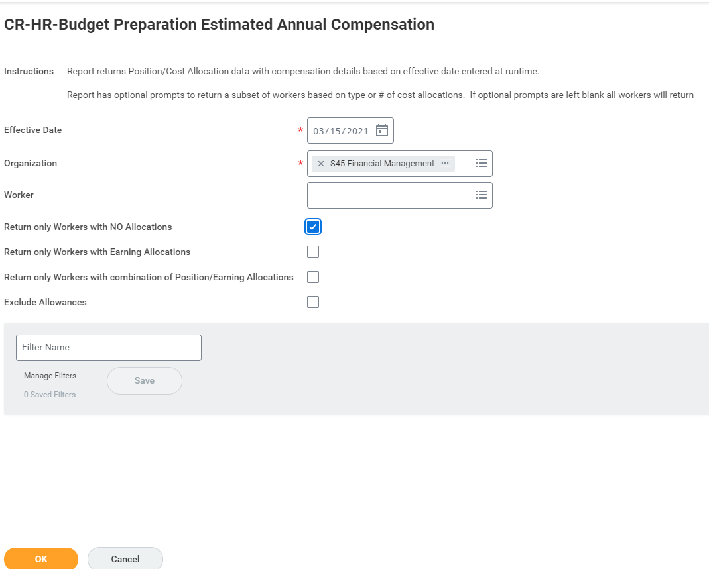

Slide 14
FY22 Personnel Budget
Step 2:
Report: CR-HR-Budget Preparation Estimated Annual Compensation
Prompt: Return only Workers with Earning Allocations
Prompt: Return only Workers with combination of Position/Earning Allocations

Slide 15
FY22 Personnel Budget
Step 2:
This report will return all Workers that have a position sitting in the Cost Center Hierarchy with a Position or Earning costing allocation on either the Base and/or Allowance Pay. For example, this means the Base Pay may not have a costing allocation but since the Allowance does, it will be reflected in this report. To determine which Pay (or both) has the costing allocation, refer to the ’Compensation Plan Amount – Annualized’ column in the ‘Worker Allocation Detail section’. The ‘Worker Allocation Detail’ section indicates where the Worker is charged and should be budgeted when there is a costing allocation. If part of the Worker’s Pay does not have a costing allocation, the Position Organization Assignment should be used for the budget.

Slide 16
FY22 Personnel Budget
Step 2:
If the Worker has multiple costing allocations within the Cost Center or outside of the Cost Center, it will be reflected in this report. If there are positions that sit outside of the Cost Center but are being charged to your Cost Center, those amounts will NOT be reflected in this report but will be captured in the ‘CR-HR-Budget Preparation Cost Allocation - Burst’ report. Due to security surrounding the ‘CR-HR-Budget Preparation Cost Allocation - Burst’ report, it has been sent via Notification to the Cost Center Manager.

Slide 17
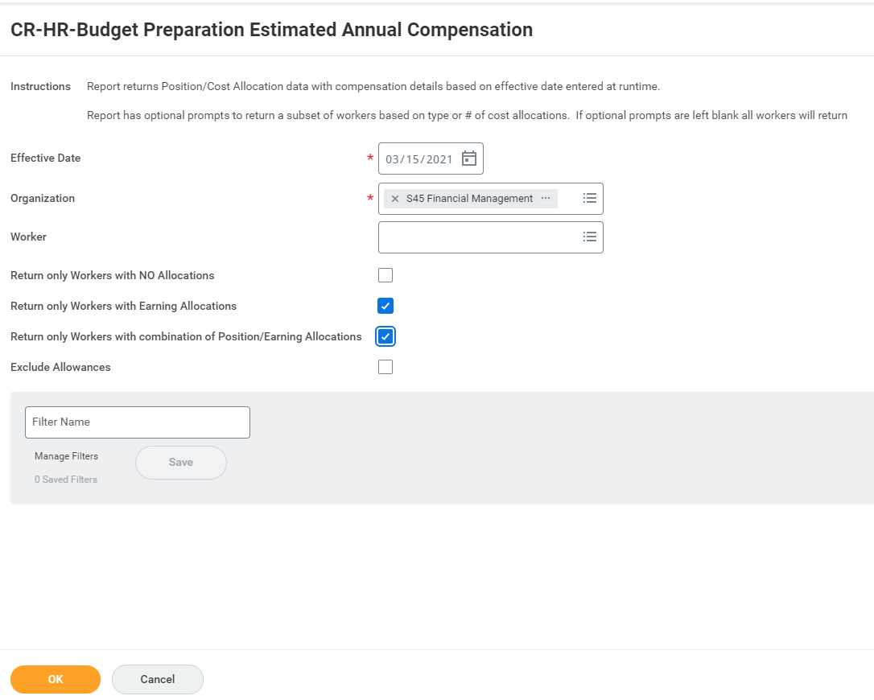

Slide 18
FY22 Personnel Budget
Step 3:
Report: CR-HR-Budget Preparation Cost Allocation – Burst
If there are positions that sit outside of the Cost Center Manager’s Cost Center but are being charged there, those amounts will ONLY be reflected in the ‘CR-HR-Budget Preparation Cost Allocation - Burst’ report. Due to security surrounding this report, Cost Center Managers cannot run it ad hoc. It is a scheduled report sent via Notification to the Cost Center Manager and you would have received it last night.

Slide 19
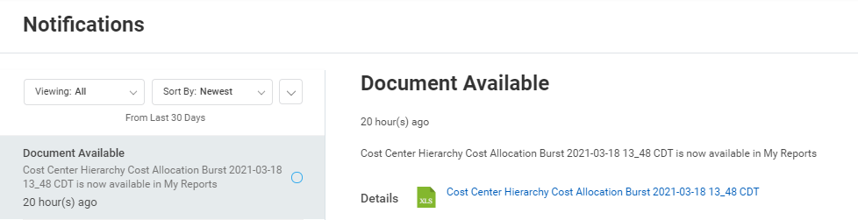

Slide 20
FY22 Personnel Budget
Step 4:
Adjuncts, Student Workers, and Graduate Assistants are excluded from the previous reports. The budgets for these Employee Types should be determined as follows or based on prior year actuals (review the ‘CR-FIN-Budget vs. Actuals by Org’) if comparable. The colleges/schools may have their own methodology as well:
  Adjuncts - # needed * rate
  Student Workers - # needed * hours * rate
  Graduate Assistants – awarded stipends

Slide 21
FY22 Personnel Budget
Step 5:
Report: View Open Positions with Reference ID
This report will return all Open Positions in the Cost Center Hierarchy. If any positions are to be filled during FY22, add the Default Position Compensation, or intended salary, to the ‘FY22 Budget Workbook’ on the appropriate Cost Center or Program tab in the correct Spend Category line of the FY22 Budget column. The fringe benefits will automatically calculate.

Slide 22
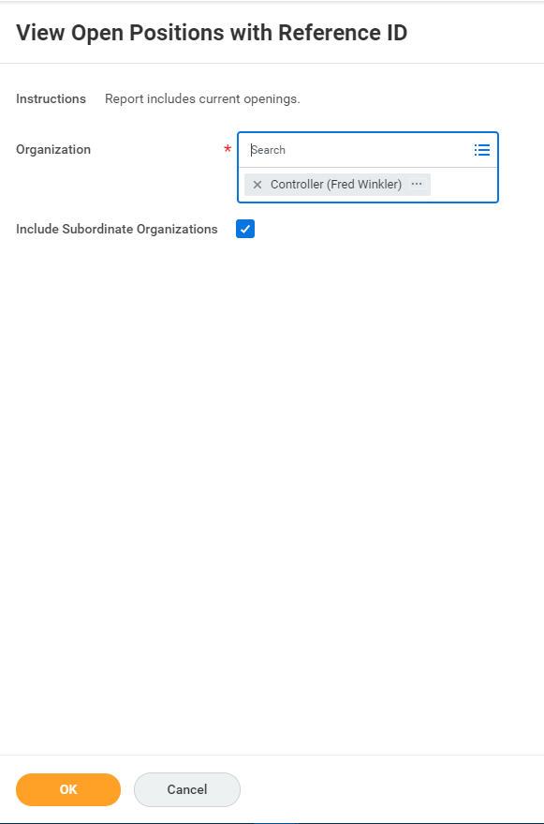

Slide 23
FY22 Personnel Budget
Step 6:
Compare the compensation and benefits totals in the ‘FY22 Budget Workbook’ to the ‘FY22 Budget Base’. Any excess should be budgeted in the ‘FY22 Budget Workbook’ to an Attrition spend category in the Vice President or Dean’s Cost Center in the FY22 Budget column. This is essentially any discretionary funding for the Vice President or Dean. The associated fringe benefits will need to be calculated manually and entered in the corresponding FB Attrition Spend Category in the FY22 Budget column.

Slide 24
FY22 General Expense Budget
The General Expense budget is included in the ‘Budget Base’ but will need to be keyed into the ‘FY22 Budget Workbook’ by Cost Center/Program and Spend Category.
General Expense budgets can be moved to different Spend Category Hierarchies within General Expense but not to/from Personnel Spend Categories.
To view your cost center’s FY21 YTD Actuals, use the ‘CR-FIN-Budget vs Actuals by Org’ report in Workday.
Another useful report is the ‘Find Budget Amendments for Organization’.
Once all expenses have been entered in the ‘FY22 Budget Workbook’, make sure the FY22 Budget column on the Summary tab agrees to the ‘FY22 Budget Base’.

Slide 25
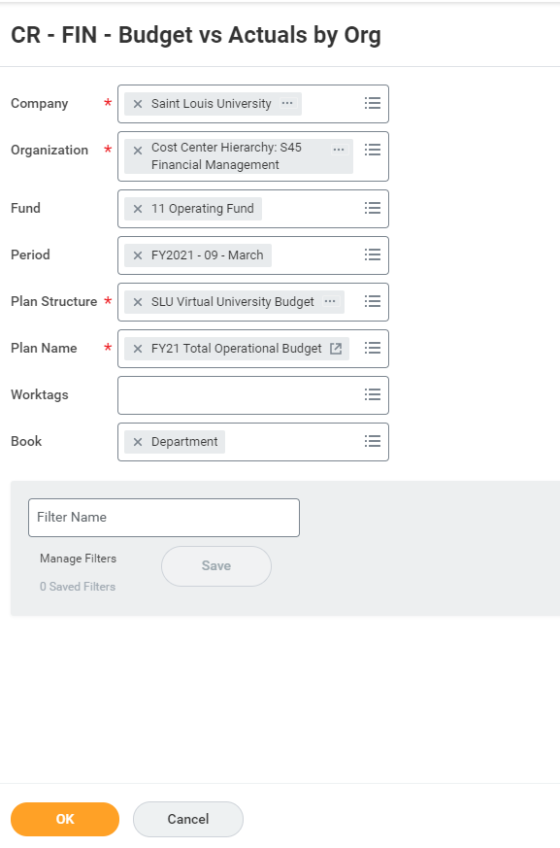

Slide 26
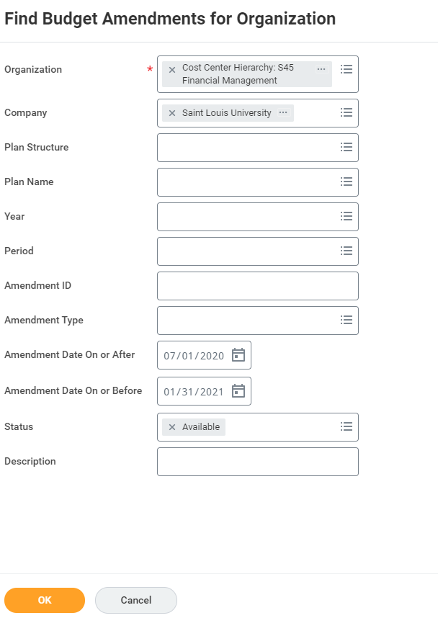

Slide 27
FY22 Compensation
Report: CR-HR-Workday Merit Compensation Excel Workbook
This report was introduced in FY21 and is used to adjust a Worker’s pay.
The only columns that can be altered in this report are salary related columns to be added that are referenced in the Guidelines.
Do not enter salary or hourly rate increases for student workers, graduate assistants/stipends, and adjunct faculty for this process.
If an Allowance needs to be adjusted, please contact Comp@slu.edu to determine if this can be done through this process or needs to be done as a Job Change/Promotion directly into Workday.
This report does not indicate funding but it can be used for comparison to the personnel budget reports and ‘FY22 Budget Base’. The merit % entered here should agree to the merit % entered in the personnel budget reports.

Slide 28
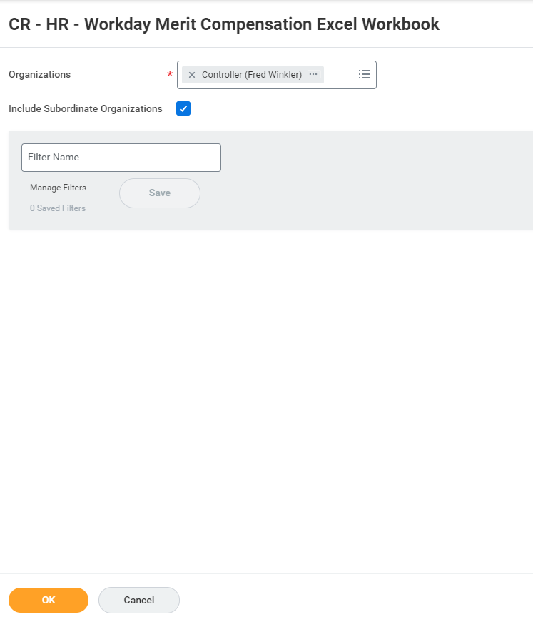

Slide 29
FY22 Budget Summary
Refer to the Guidelines.
Contact budgetoffice@slu.edu with any report access issues.
Schedule individual session to review budget and compensation files and walk through the process with YOUR Cost Center information.
SLUCare:
  Personnel Budget guidelines are applicable but see SLUCare specific notes for additional detail
  Budget Instructions were sent March 8th
  Training session Workday Reporting for Budgeting and Forecasting- SLUCare was held on March 10th
Questions?

Slide 30
Workday Support
budgetoffice@slu.edu - Budget or Budget Amendment
mcfinance@health.slu.edu - SluCare Customer Accounts
treasuryservices@slu.edu - Non-SluCare Customer Account
accountspayable@slu.edu - Accounts Payable functions
cardprograms@slu.edu - AMEX P cards or T & E cards
univtravel@slu.edu - Trip ID or anything Concur
sludeposits@slu.edu - Departmental Deposits via Ad Hoc Bank Transaction
supplieraccounts@slu.edu - Supplier requests or updates
billikenbuyadmin@slu.edu - Billiken Buy or anything Procurement
grants@slu.edu - Awards, Award Proposal, Grants
hr@slu.edu - Human Capital Management (HCM), Talent & Learning
facilitiesdatamanagement@slu.edu - Workday Location
accountingservices@slu.edu - FDM, Financial Accounting, Projects, Business Assets, Internal Service Delivery (ISD), or Endowments

Slide 31
Business Manager Meeting
  March 23, 2021

