Slide 1
Annual Title IX Training 2023-2024

Slide 2
Why are we here?
Fulfill not only our obligations under Title IX law, but to ensure we are carrying out the mission of the University;
You have an important role that directly impacts the personal dignity and safety of the University community;
How you interact with those involved in the Title IX process will impact their experiences and understanding of the Title IX response at SLU.
Notes:
Individuals on this training have important role beyond that shared by all members of the University community – you are here today because you have a responsibility to implement the University’s Title IX policy, which means you make decisions that directly impact the personal dignity and safety of the University community. The ways in which you interact with all persons in this process – complainants, respondents, advisors, witnesses – will have an impact on those individuals and their experiences at the University and beyond.

Slide 3
Role in the Title IX Sexual Harassment Policy
Investigators and Panel members must be fair, impartial, and unbiased.
  Must approach the process without pre-judgment – determinations must be based on application of policy to the specific information brought forward in the process.
Advisors provide support to their party and ensure that the party understands their rights and options under the Policy.

Slide 4
Agenda
Intro of OIED
Status of Regulations
Overview of Current Regulations (2020)
Scope of Policy
Important Definitions
Grievance Process

Slide 5
INTRODUCTIONS
Office of Institutional Equity & Diversity (DuBourg rm36)
Justin Lacy – Director
  Justin.lacy@slu.edu
Anna Kratky – Title IX Coordinator
  314-977-3886 (8:30-5pm) office
  314-580-8730 (after hours) emergency/on-call
  anna.Kratky@slu.edu
Sara Zapien – Equity Officer/Title IX Investigator
  Sara.zapien@slu.edu
Kim Sahr – Equity Officer/Title IX Investigator
  kim.sahr@slu.edu

Slide 6
Status of Title IX Sexual Harassment Policy (TIX Policy)
There are no changes to the Title IX Sexual Harassment Policy this year.
The DOE has not released their final rule. It was set to be released this month, but now it appears to be something schools can look for in the spring, or even summer.
There will be no changes to SLU’s policy(s) until there is a final rule that has become law.

Slide 7
Overview/Reminders of 2020 Regulations
Must respond in a way that is not deliberately indifferent when school has actual knowledge of sexual harassment
“Sexual harassment” is defined by the regulations
Must offer supportive measures
Requires a signed formal complaint to start the grievance process
Formal complaints must be dismissed if they do not meet the jurisdictional requirements

Slide 8
Overview/Reminders of 2020 Regulations
Regulations include specific requirements for the grievance process used to address formal complaints
Decision maker must be separate from investigator (no single investigator model)
Must include a live hearing with the opportunity for parties’ advisors to cross examine other parties/witnesses should those parties/witnesses decide to participate/respond.

Slide 9
Scope of the TIX Policy

Slide 10
Scope of the TIX Policy
The TIX policy applies to Prohibited Conduct that occurs:
  On campus;
  In the context of a university program or activity, which includes locations, events, and circumstances where the university has substantial control over the Prohibited Conduct and the person accused of having committed the Prohibited Conduct.
Notes:
How has this changed? Scope of prior policy –
“This Policy applies to all acts where the conduct: • Occurs on campus; • Occurs in the context of a University program or activity; or • Occurs off campus and has continuing adverse effects on campus or in the context of a University program or activity. “

Slide 11
Scope of the TIX Policy
Conduct that occurs outside the United States, including on the campus of SLU-Madrid, is not covered by this policy. The Office of Student Life at SLU-Madrid is the reporting contact for all matters of Prohibited Conduct that fall under the SLU-Madrid Code of Conduct.
Notes:
Regulations limit “sexual harassment” to conduct that occurs in the United States.
Note – conduct that does not fall within this policy is likely addressed in other policies. For examples, conduct that previously was covered by the Sexual Misconduct policy occurring in Madrid, would fall within the SLU-Madrid Code of Conduct and be addressed subject to that policy.

Slide 12
Scope of the TIX Policy
When Respondent is an enrolled student, faculty, or staff at the university, the procedures outlined in Section 2.11 of this policy apply.
When Respondent is a third party…the university will offer and implement supportive measures to the Complainant consistent with the goals of this policy…

Slide 13
Scope of the Grievance Process
In order to initiate the grievance process, a Formal Complaint must be filed.
A Formal Complaint may be filed by the Complainant or Title IX Coordinator.
At the time of filing the Formal Complaint, the Complainant must be participating in or attempting to participate in an education program or activity at Saint Louis University

Slide 14
Scope of the Grievance Process
The Title IX Coordinator must dismiss a Formal Complaint if:
  The Formal Complaint does not allege circumstances that meet the definition of “sexual harassment” if proven;
  The conduct did not take place within an education program or activity;
  The conduct did not occur within the United States; or
  The Formal Complaint is not signed by someone who meets the definition of a Complainant.

Slide 15
Scope of the Grievance Process
The Title IX Coordinator has discretion to dismiss a Formal Complaint if:
  The Complainant notifies the Title IX Coordinator that they wish to withdraw the Formal Complaint;
  The Respondent is no longer enrolled at or employed by Saint Louis University; or
  There are circumstances that prevent Saint Louis University from gathering the necessary information to make a determination regarding responsibility.

Slide 16
Scope of the Grievance Process
If a Formal Complaint is dismissed under this policy, the university may address the Prohibited Conduct as a violation of the Student Code of Conduct, the Faculty Manual, or the Staff Performance Management Policy.
In those instances, the Complainant will be directed to the appropriate office.

Slide 17
Prohibited Conduct

Slide 18
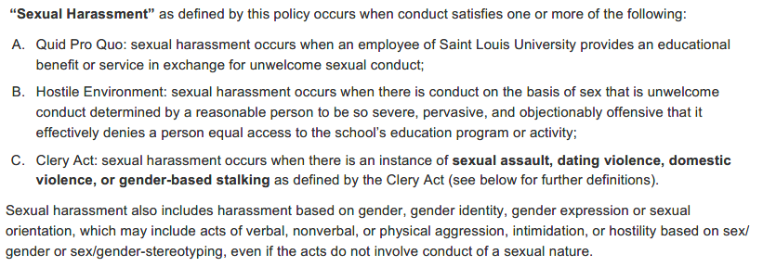
Sexual Harassment

Slide 19
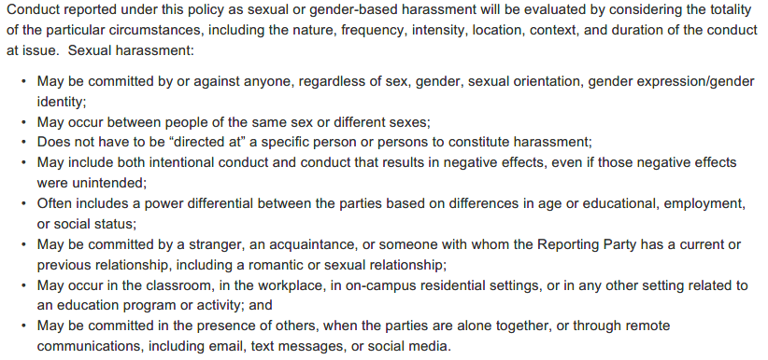
Sexual Harassment

Slide 20
Sexual Assault
Sexual Assault refers to an offense that meets the definition of rape, fondling, incest, or statutory rape as used in the FBI’s Uniform Crime Reporting System. These sexual offenses include instances where the Complainant is incapable of giving consent.
Notes:
The term sexual exploitation is not a part of the policy – falls under sexual harassment or conduct in student handbook.
Definition of “sexual exploitation found in prior version of policy: “Sexual Exploitation” occurs when an individual takes non-consensual or abusive sexual advantage of another for their own advantage or benefit, or to benefit or advantage anyone other than the person being exploited, and that behavior does not otherwise constitute any other form of Prohibited Conduct. Examples of Sexual Exploitation include, but are not limited to: • invasion of sexual privacy, including observing or allowing another individual to observe another’s nudity or sexual activity without the Effective Consent of all individuals’ involved; • prostituting another person; • non-consensual video or audio-taping of sexual activity; • engaging in voyeurism; • knowingly exposing another individual to a sexually transmitted infection or virus without that individuals’ knowledge of the exposure; • exposing or inducing another to expose their genitals without consent; or • inducing incapacitation for the purpose of making another person vulnerable to non-consensual sexual activity.

Slide 21
Sexual Assault
Rape refers to penetration, no matter how slight, of the vagina or anus with any body part or object, or oral penetration by a sex organ of other person, without the consent of the Complainant, including instances in which the Complainant is incapable of giving consent.

Slide 22
Sexual Assault
Fondling refers to the touching of the genitals (including vagina, penis or anus), the breasts, or the buttocks of another person for the purpose of sexual gratification, forcibly and/or against that person’s will; or not forcibly or against that person’s will where the Complainant is incapable of giving consent because of their youth or because of their temporary or permanent mental incapacity.

Slide 23
Sexual Assault
Incest refers to the non-forcible sexual intercourse between persons who are related to each other within the degree wherein marriage is prohibited by law.
Statutory Rape refers to non-forcible sexual intercourse with a person who is under the statutory age of consent.

Slide 24
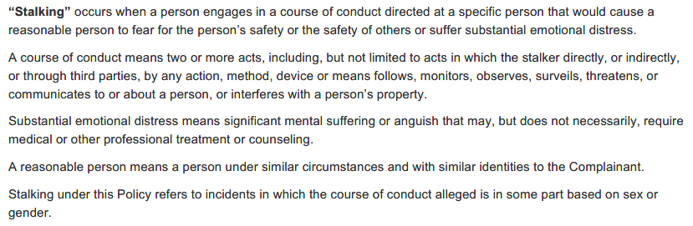
Stalking

Slide 25

Dating Violence

Slide 26
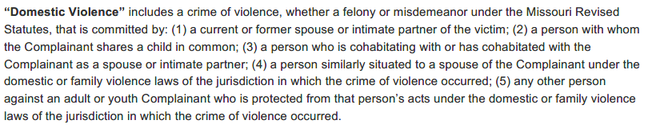
Domestic Violence

Slide 27
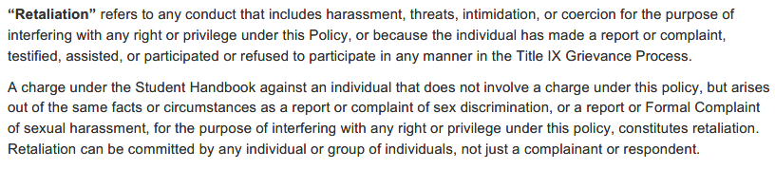
Retaliation
Note: Allegations of retaliation are addressed under different University policies.

Slide 28
Other Definitions

Slide 29
Complainant and Respondent
The Complainant is an individual who is alleged to be the victim of conduct that could constitute sexual harassment, as defined by this policy.
  Complainant must be someone that is enrolled or attempting to enroll or employed by the University.
The Respondent is an individual who has been reported to be the perpetrator of conduct that could constitute sexual harassment, as defined by this policy.
  Respondent can be anyone – affiliated with the University or not.

Slide 30
Effective Consent

Slide 31
Effective Consent
Effective Consent is an affirmative, knowing, and voluntary decision – clearly communicated through mutually understandable words (e.g. saying “yes”) and/or actions – to willingly engage in mutually acceptable sexual activity (e.g. to do the same thing, at the same time, in the same way, with another individual(s)).

Slide 32
Effective Consent
Effective Consent must be given freely, willingly, consciously and knowingly by each participant to any desired sexual contact.
Consent may be withdrawn by any consenting party at any time during the sexual activity. Withdrawal of consent must be demonstrated by words and/or actions that indicate a desire to end sexual activity. Once an individual has communicated withdrawal of consent, all sexual activity must end.

Slide 33
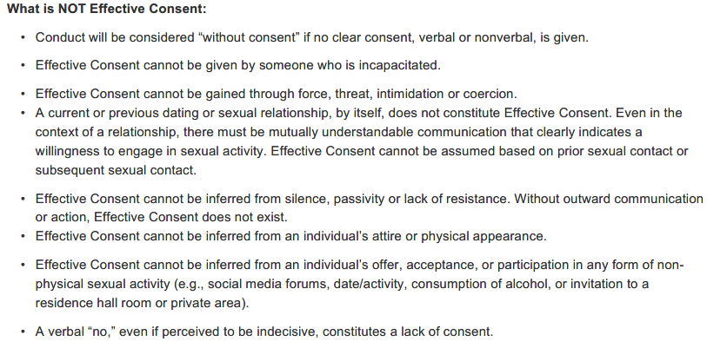

Slide 34
Effective Consent
Responsibility of the person initiating sexual activity to obtain the other party’s Effective Consent (not the responsibility of the intended recipient of such sexual contact to affirmatively deny such contact).
All parties must have Effective Consent throughout the duration of the sexual activity

Slide 35
Effective Consent
Effective Consent can be given by words and/or actions. Relying solely on non-verbal communication, however, can lead to misunderstanding and as a result, a potential policy violation.
Effective Consent to one form of sexual activity is not, by itself, consent to other forms of sexual activity.

Slide 36
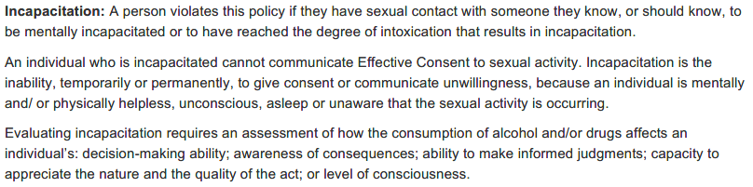
Incapacitation and Effective Consent

Slide 37
Signs of Incapacitation
A person is considered incapacitated, or unable to give consent, if they cannot understand the when, where, why, how, or who of a sexual encounter.
Warning signs include:
  Difficulty walking, stumbling, or falling down;
  Being unable to stand or walk without assistance;
  Slurred speech or an inability to communicate clearly;
  Inability to focus or confusion about what is happening;
  Urinating, defecating or vomiting; or
  Combativeness, emotional volatility or other marked change in demeanor.

Slide 38
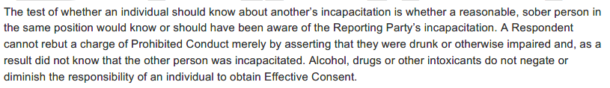
Incapacitation and Effective Consent

Slide 39
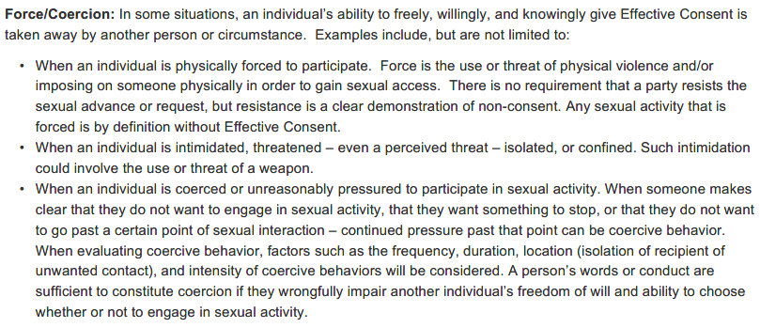
Force/Coercion and Effective Consent

Slide 40
Serving Impartially
Avoiding prejudgment, conflicts of interest, and bias

Slide 41
Serving Impartially
Important that throughout process, individuals who administer process maintain an open mind – that they are neutral and unbiased.
Only form an opinion at the conclusion of the process.

Slide 42
Serving Impartially
Be mindful of prior interactions or relationships that may give the appearance of a conflict of interest – and make the Title IX Coordinator aware if any arise.
Decision-makers are not charged with finding a particular outcome and should avoid pre-conceived notices and consider only the information provided during the process.
And, decision-makers must treat both parties equitably and with respect.

Slide 43
The Grievance Process

Slide 44
Overarching Principles
Both the Complainant and the Respondent will be treated equitably;
There will be an objective evaluation of all evidence, both inculpatory and exculpatory, and a determination of credibility will not be made based on a person’s status as a Complainant, Respondent, or witness;
The Title IX Coordinator, Investigators, and adjudicators will be trained and free from any conflict of interest;
The Respondent will be presumed not responsible throughout the Grievance Process unless a finding of responsibility is made at the conclusion of the Grievance Process.
Each Party has the right to appeal a decision made by the hearing panel;

Slide 45
Overarching Principles
Each Party will be provided the range of available support measures and these measures will remain an option for the Parties throughout the Grievance Process;
Each Party will be provided a range of possible sanctions should the end of the Grievance Process result in a finding of responsibility:
The university will adhere to reasonably prompt timeframes for the resolution of all Formal Complaints, but will allow for delays with good cause;
Evidence of information that is protected by a legally recognized privilege, for example, conversations between a doctor and patient or attorney and client, will not be included in the Grievance Process without written consent from the Party holding the privilege;
The preponderance of the evidence is the standard of evidence utilized throughout the entirety of the Grievance Process.

Slide 46
Formal Complaint

Slide 47
Formal Complaint
First step – Filing a Formal Complaint
A Formal Complaint is a document filed and signed by a Complainant or signed by the Title IX Coordinator alleging Prohibited Conduct against the Respondent and requesting that the university investigate the allegation of Prohibited Conduct. At the time of filing a Formal Complaint, a Complainant must be participating in or attempting to participate in an education program or activity at Saint Louis University. The Complainant cannot be anonymous and must sign their name on the Formal Complaint.

Slide 48
Formal Complaint
If a Complainant chooses not to file a Formal Complaint, the Title IX Coordinator will assess the available information and whether to file a Formal Complaint.
  Requires analysis of circumstances, and notice to the Complainant.
Notes:
The policy provides quick a few guardrails around this - to include the factors that the TIX Coordinator will consider.
Also makes clear that the University will, in most cases, try to respect the wishes of the Complainant – so, this is a rare situation.

Slide 49
Formal Complaint
Once a Formal Complaint is filed, the Title IX Coordinator will conduct an initial assessment to determine whether the allegations fall within the scope of this policy.
Title IX Coordinator will evaluate whether the mandatory or discretionary dismissal requirements apply.
Both Complainant and Respondent will receive notice if the Formal Complaint is dismissed.
Notes:
We talked last time about scope – review the parties involved, the conduct alleged to have occurred, and the location of such conduct.
**Again – note that if a Formal Complaint is dismissed based on the TIX Sexual Harassment policy, the University may address the Prohibited Conduct as a violation of the Student Code of Conduct, the Faculty Manual, or the Staff Performance Management Policy.

Slide 50
Notice

Slide 51
Notice
If the Title IX Coordinator confirms that a Formal Complaint should proceed, Complainant and Respondent then receive notice in writing, including:
  The allegations including the date, time, location, parties involved, and the conduct alleged to have occurred
  The corresponding policy violations under this policy and/or other relevant university policy
  An explanation of the Grievance Process and their rights under this policy
  The presumption that the Respondent is not responsible for any policy violation prior to a finding of such at the conclusion of the Grievance Process

Slide 52
Notice
Notice will also include:
  The right to an advisor;
  The use of the preponderance of the evidence standard;
  The right to inspect all information and evidence collected during the Grievance Process;
  A proposed date and time to meet with the investigator
  The available supportive measures;
  The range of possible sanctions should the end of the Grievance Process result in a finding of responsibility.

Slide 53
Advisor

Slide 54
Right to an Advisor
Throughout the process, a Complainant or Respondent may have an advisor provided by the University or an advisor of their choice present at any meeting or proceeding related to the investigation or Grievance Process.
Party may decide not to use an advisor, except for the hearing

Slide 55
Right to an Advisor
Advisor may be an attorney (but is not required to be)
University provided advisors are trained on the grievance process
The advisor may not be a fact witness or otherwise have any conflicting role in the process.

Slide 56
Role of an Advisor
Advisors may participate in university processes in an advisory capacity, but they may not take part directly in the investigation, hearing, or appeal, with the exception of conducting cross-examination during a hearing.
If a Party wishes to speak privately with their advisor during the investigation or hearing, they may request a brief recess from the meeting or proceeding.
The university has the right to determine what constitutes appropriate behavior on the part of an advisor as discussed in the Rules of Decorum.

Slide 57
Role of an Advisor
During the hearing, the hearing chair will enforce the Rules of Decorum – if a Party’s advisor violates the Rules of Decorum repeatedly, the hearing chair can decide to remove the advisor from the hearing
Advisors may engage in cross examination of the other Party and witnesses, but may only ask relevant questions
Reminder: Parties and witnesses may choose not to answer one or all of an Advisor’s questions.

Slide 58
Timeframe
Grievance process should be completed within 90 calendar days
May extend the time frame for good cause, and will communicate the delay and the reason for delay to the Parties
Good cause may include: the complexity of the circumstances of each allegation, the integrity and completeness of the investigation, to comply with a request by external law enforcement, to accommodate the availability of witnesses, to account for university breaks or vacations, or to address other legitimate reasons.

Slide 59
Investigation

Slide 60
Investigation
Title IX Coordinator will assign a trained investigator to conduct a prompt, thorough and impartial investigation to conduct a fair and reliable fact-gathering based on the allegations in the Formal Complaint.
It is the responsibility of the university, not the Parties, to gather relevant information, to the extent reasonably possible.
All Parties and witnesses are expected to provide truthful information.

Slide 61
Investigation
The investigator will be responsible for:
  interviewing the Complainant and the Respondent, interviewing potential witnesses;
  collecting relevant documentation and physical evidence, including documents, communications between the Parties, and other electronic records as appropriate;
  creating a timeline; and
  preparing a written report documenting the complete investigation.

Slide 62
Investigation
Both Complainant and Respondent have the equal opportunity to be heard, submit evidence/information, and identify witnesses.
Witnesses must have observed the acts in question, have information relevant to the incident, or offer information that speaks to a Party’s individual’s character.
No gag orders on the Parties.
The investigator will send each Party and their advisor a written notice of investigative interviews, meetings, and proceedings.

Slide 63
Investigation – Privileged Records
Investigator will not have access to privileged records without consent of the Party (including medical records, psychiatric or counseling records, communications with attorneys, or communications with clergy).
If a Party chooses to share such information, it will become a part of the investigation and be available to the other Party.

Slide 64
Investigation – the Report
Investigator will prepare a report that:
  Summarizes the information gathered during the investigation,
  Identifies potential policy violations, and
  synthesizes the areas of agreement and disagreement between the parties and any supporting information or accounts

Slide 65
Investigation – the Report – Chance to Review
Parties have 10 days to review the report and evidence before it is finalized, and may submit additional comments or information to the investigator.
The finalized report, including appropriate comments submitted by either Party, will be given to the hearing panel.

Slide 66
Hearing

Slide 67
Hearing
Title IX Coordinator will appoint a hearing panel of three trained individuals, who are equal decision-makers
Minimum two of three panelists must decide that it is more likely than not that the Respondent is responsible in order for a finding of responsible to be made
Title IX Coordinator will appoint one panelist to serve as the hearing chair

Slide 68
Hearing Chair
Hearing Chair:
  Chooses a date for the hearing and provides written notice to the Parties
  Inquires about Parties’ advisors for the hearing
  Creates an audio/audiovisual recording of the hearing
  Ensures the hearing occurs in a timely fashion
Notes:
Administrative Tasks -

Slide 69
Hearing Chair
Hearing Chair:
  Conducts the hearing proceedings
  Answers questions about the Rules of Decorum
  Upholds the Rules of Decorum and decides when to remove an individual for violating the Rules

Slide 70
Rules of Decorum
Requires all participants to conduct themselves in an appropriate and respectful manner
Advisors and panelists may not ask repetitive or argumentative questions
Participants may not raise their voices or yell and may not interrupt others when speaking

Slide 71
Hearing Chair
Hearing Chair:
  Provides preliminary decisions on relevancy of topics for the hearing, and makes final relevancy determinations for questions asked at the hearing
  Provides explanations during the hearing if questions are excluded based on relevance
  Summarizes the hearing panel’s decision in a written document

Slide 72
Hearing
Hearings conducted using video-conferencing technology
Hearing chair makes opening remarks, including the identity of the Parties and their advisors, what university policy violation(s) are alleged to have occurred, the application of the preponderance of the evidence standard, and a review of the expectations outlined in the Rules of Decorum.
Parties have the opportunity to make opening statements (Advisors may not make opening statements, only Parties)

Slide 73
Hearing – Complainant’s testimony
Complainant invited to answer relevant questions from the hearing panel
After the panel’s questions are completed, the Respondent’s advisor may engage in cross examination of the Complainant. Up to Complainant whether they will answer.
The hearing chair will determine if each question from the advisor is relevant before the Complainant answers
If the Respondent and their advisor does not appear at the hearing, the university will provide an advisor to conduct the cross examination of the Complainant.
Notes:
You’re going to see this same pattern repeated – for Complainants, Respondents, Witnesses.
Panel asks questions first –
***This involves pre-work – you will want to review everything in advance, and determine what questions to ask.
** Your outcome depends on information obtained during the hearing – different than a situation where a decision-maker uses the hearing only to clarify items they have questions about; instead, the decisions must rely on information brought out during the hearing.
Prepare questions in advance; determine which panel member will ask them.
The parties’ advisors will then have the ability to ask questions – not the italicized language – after each question by an advisor is asked and before an answer is provided, the hearing chair will determine if each question is relevant. Think about setting the expectation of that cadence – so that everyone understands there will be a *pause* after a question from an advisor from either party.
*We’ll take about relevance in a little while**

Slide 74
Hearing – Respondent’s testimony
Respondent invited to answer relevant questions from the hearing panel
After the panel’s questions are completed, the Complainant’s advisor may engage in cross examination of the Respondent. Up to Respondent whether they will answer.
The hearing chair will determine if each question from the advisor is relevant before the Respondent answers

Slide 75
Hearing
After the Parties have been questioned, the hearing chair will call each witness requested by either Party or determined by the Hearing Panel to be necessary.
Each witness will be questioned by the hearing panel, and then by each Party’s advisor (alternating which Party questions first). Again it is up to the witness whether they will answer the questions asked of them.
Hearing chair will determine if each question from the advisors is relevant before the witness answers

Slide 76
Reminder of 2021 Revision to the TIX Policy
In August 2021, the DOE released guidance that stated they would cease to enforce §106.45(b)(6)(i) of the Title IX Final Rule regarding the prohibition against statements not subject to cross-examination.
Hearing panelists may now consider a statement that is made by a Party or witness during the investigation or hearing without that statement being subject to cross-examination at a live hearing in reaching a determination of responsibility.

Slide 77
Implications of 2021 Policy Change
A Party or Witness may choose not attend the live hearing at all and their statement provided during the investigation may be considered by the hearing panel as part of the deliberations.
A Party or Witness may choose to attend the live hearing and answer some or all of the questions asked of them by the hearing panel OR the advisor. If the Party or witness refuses to answer questions, the entirety of their statement during the investigation and the information they provide at the hearing may be considered by the hearing panel as part of the deliberations.

Slide 78
Implications of this Policy Change
If the hearing panel has unanswered questions or concerns that are not addressed because the hearing panel is unable to question a Party or witness, this may impact the deliberations and ultimate decision of the hearing panel.

Slide 79
Hearing
If a Party or witness does not attend the hearing and submit to cross examination, the hearing panel may rely on any statement made by that Party or witness in reaching a determination regarding responsibility.
The hearing panel is not permitted to draw an inference about the determination regarding responsibility based solely on the absence of a Party or witness from the hearing or their refusal to answer questions from the hearing panel or during cross examination. But if there are questions left unanswered, they may impact the determination.

Slide 80
Hearing
Each Party will have the opportunity to make a closing statement (Advisors may not make closing statements, only Parties)
A closing statement may include a summary of the information shared during the hearing and the impact the Party believes it has on the decision before the hearing panel.
It may also include how the Party has been impacted by the allegations and what their desired outcome of the hearing is.

Slide 81
Relevance Determinations

Slide 82
Relevance
Relevant questions are those that call for information that will assist the members of the hearing panel in deciding whether the allegation(s) and information in the investigation is either more or less likely to be true.
A question cannot be excluded on the basis of relevance solely because it calls for prejudicial evidence or evidence of character.

Slide 83
Relevance
Questions concerning the Complainant’s sexual history are not relevant unless offered to prove that someone other than the Respondent committed the conduct alleged by the Complainant or if the questions and evidence concern specific incidents of the Complainant’s prior sexual behavior with respect to the Respondent and are offered to prove consent.
Notes:
Note – this is the only line of questioning that is CATEGORICALLY prohibited. For other types of questions, will need to rely on the standard of: is it “information that will assist the members of the hearing panel in deciding whether the allegation(s) and information in the investigation is either more or less likely to be true.”

Slide 84
Written Determination

Slide 85
Written Determination of Responsibility
The written decision will include the following:
  Identification of each allegation and the corresponding policy violation;
  An explanation of the procedural steps taken through the entirety of the Grievance Process;
  A determination regarding responsibility for each alleged policy violation;
  Findings of fact made by the hearing panel that led to their decision, conclusions about whether the alleged conduct occurred, and a rationale for the finding for each alleged policy violation;
  Any disciplinary sanctions imposed on the Respondent;
  Any remedies will be provided to the Complainant;
  An explanation of each Party’s right to appeal and the appeal process.
Notes:
Recall:
If a Party or witness does not attend the hearing and submit to cross examination, the hearing panel must not rely on any statement made by that Party or witness in reaching a determination regarding responsibility.
The hearing panel is also not permitted to draw an inference about the determination regarding responsibility based solely on the absence of a Party or witness from the hearing or their refusal to answer questions from the hearing panel or during cross examination.

Slide 86
Sanctions

Slide 87
Sanctions
Sanctions for a violation of this policy by a student may include: expulsion; suspension; disciplinary probation; mandated counseling assessment which may include anger management course(s), alcohol and/or drug education program(s), and other requirements based upon the counseling assessment; restrictions on campus privileges including restrictions on campus housing or participation in student activities; community service; and/or other educational sanctions.
Sanctions for a violation of this policy by an employee may include: leave with pay, leave without pay, termination, change in job responsibilities or duties, relocation of assignment, mandated counseling or anger management assessment, mandated training, such as sexual harassment training.

Slide 88
Appeals

Slide 89
Appeals
Either Party may appeal the decision of the hearing panel, or of a dismissal by the Title IX Coordinator
Appeals are due within 3 days of the decision being appealed
Title IX Coordinator will appoint an appeal panel of three individuals

Slide 90
Appeals
The grounds for appeal may only be one or more of the following:
  There was a material deviation from the procedures set forth in this policy or applicable provisions of the Student Handbook that would significantly impact the outcome of the case or may have resulted in a different finding;
  New or relevant information, not available at the time of the investigation or hearing, has arisen that would significantly impact the outcome of the case;
  The Title IX Coordinator, investigator, or member of the Hearing Panel had a conflict of interest or bias that affected the outcome of the case.
Dissatisfaction with the outcome of the investigation, and failure of a Party or witness to attend or participate in the investigation or hearing process, are not grounds for appeal.

Slide 91
Appeals
The non-appealing Party will have the opportunity to review the appeal and will have 3 days to submit a response.
Appeals are not intended to be a full rehearing of the report and are generally limited to a review of the written documentation and pertinent documentation for the appeal.
Absent extraordinary circumstances, the appeal panel does not meet with either Party.
The decision of the appeal panel is final and should generally be completed within 15 business days.

Slide 92
Responsible Employee Reminders

Slide 93
SUPPORTIVE MEASURES & RESOURCES
  Academic Accommodations/Notifications
  Housing Accommodations/changes
  Counseling
  No Contact Order/Ban From Campus
  Safety Escorts
  SLMPD/law enforcement
  Supportive Measures will be tailored to fit the needs of each individual student

Slide 94
HOW TO MAKE A TIX REPORT
  Title IX Coordinator – Anna Kratky
    Anna.Kratky@slu.edu 314-580-8730
  Office of Institutional Equity and Diversity
  Dept of Public Safety
  Housing & Residence Life
  Dean of Students Office
  Any SLU employee except confidential resources

Slide 95
CONFIDENTIAL RESOURCES
  University Counseling Center
  Medical Professionals
    SLU Hospital
    Student Health Center
  Clergy/Ordained Ministers
  Integrity Hotline

Slide 96
HOW TO RESPOND TO A REPORT
  FIRST PRIORITY REMAINS THE STUDENT. Listen. Support. Respond
    Listen to the student
    Let them know you are there to assist/support them
      Offer immediate resources (medical, law enforcement, counseling, housing) and connect them with those resources if they request them

Slide 97
HOW TO RESPOND TO A REPORT
  Not an investigative interview;
  Alert them that you will have to tell Title IX Coordinator;
  Tell Anna by sending an email or calling within 24 hours.
  Detail everything that the student shared, paying close attention to:
    Where the incident occurred;
    When the incident occurred ;
    Name of accused person.

Slide 98
HOW TO RESPOND TO A REPORT
  Examples of language:
    Appropriate –
      “I am sorry you are going through this”
      “I can see this is very difficult, I am here to help”
      “SLU has a Title IX Coordinator who is going to be able to help you understand all your options and resources”
      “You are not alone, we are here to help”
    Inappropriate –
      “I believe you” (instead try “I am here to help”)
      “SLU will hold this person accountable/kick them out” (that is up to the Grievance Process)

Slide 99
Questions?

Slide 100
Thank you all for the dedication and compassion you have for this work and the service to our community!!
Anna Kratky
Title IX Coordinator
DuBourg Hall, Room 36
314-977-3886
anna.kratky@slu.edu

